Slide 1
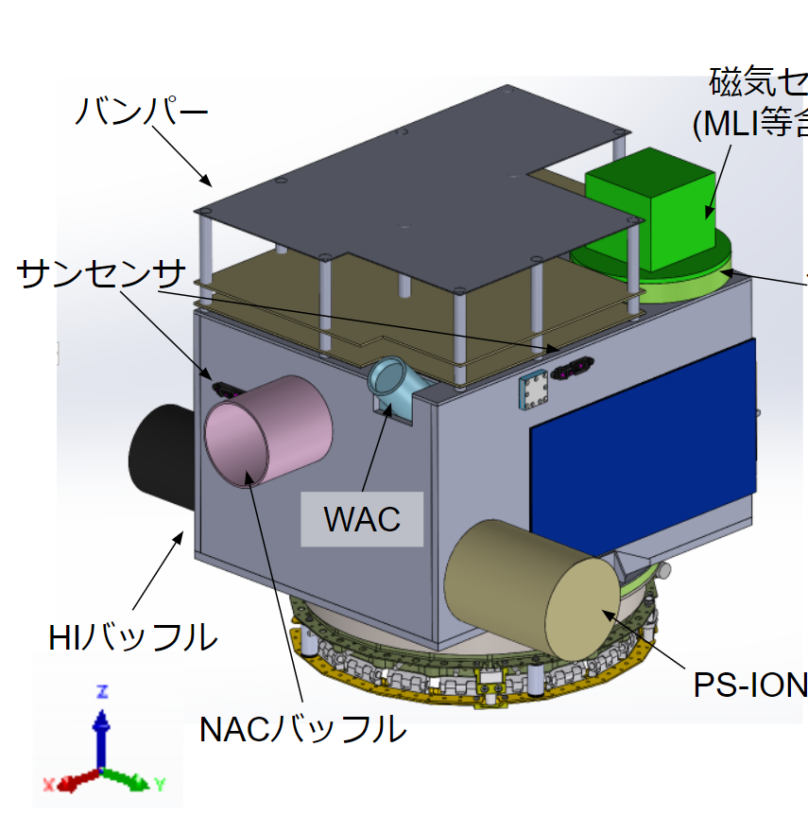
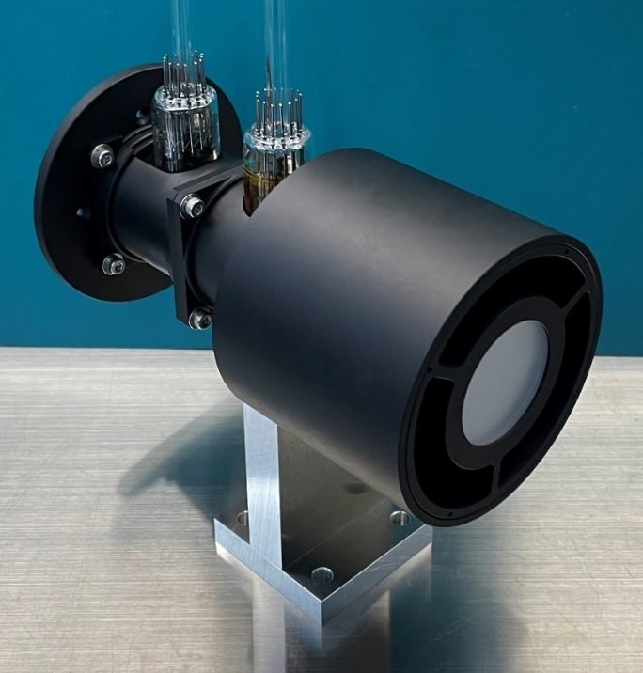
Hydrogen Lyman-alpha Imager (HI)
Kazuo Yoshioka, Go, Murakami, Masaki, Kuwabara,
Makoto Taguchi, Shingo Kameda Ichiro Yoshikawa, and HI team
HI (baffle)
PS-ION
HI BBM
NAC (baffle)
2022.07.08 CI Oxford MTG

Slide 2
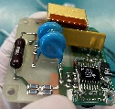
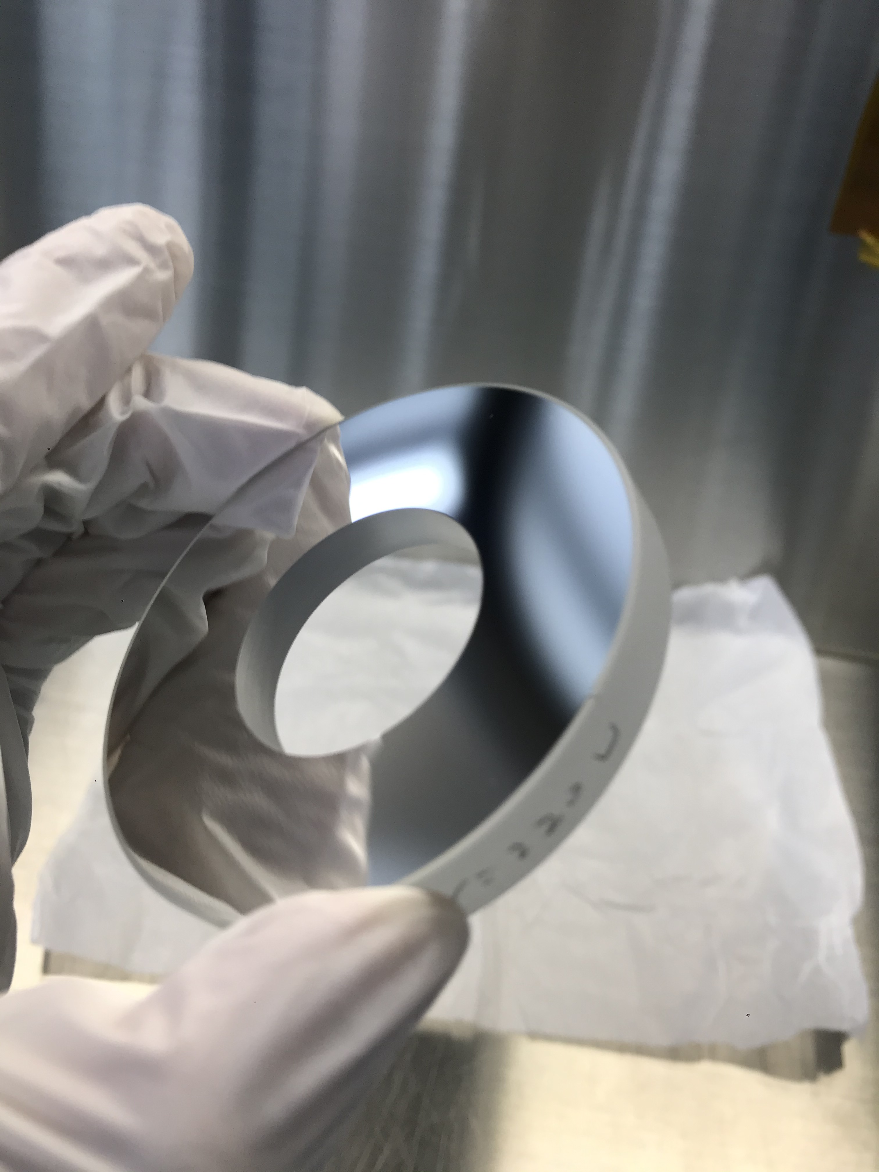
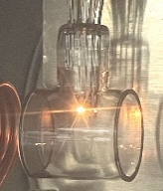
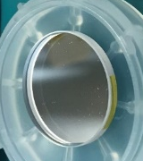
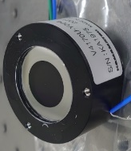
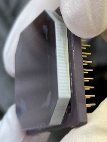
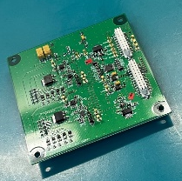
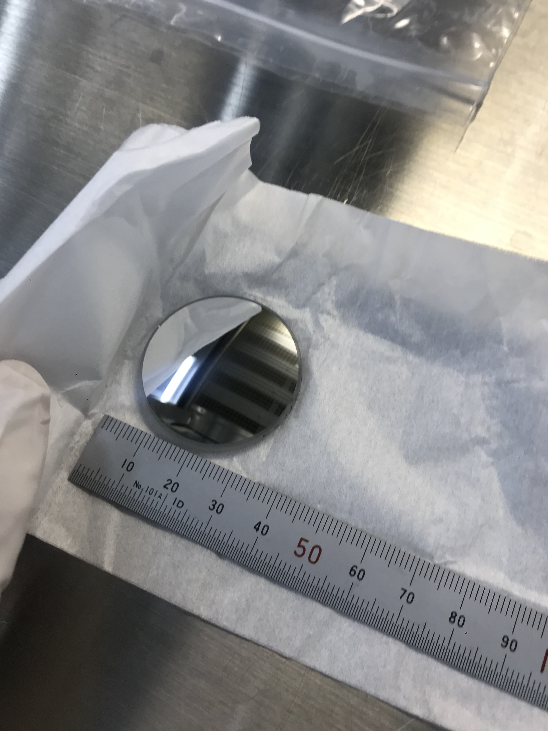
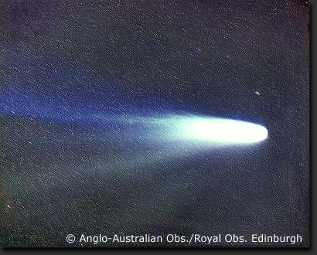
Block diagram and specifications
Cassegrain-type optics
Absorption filters
Band-pass filter
Photon detector
Elec.
Target
photon correction
Ly-alpha block
121.534nm (H)
121.567nm (D)
Bandpass (115-125nm
・Photon counting
・Imaging
Optics | Photon correction by Cassegrain-type telescope.
Absorption filters | H Ly-α (121.567nm) blocking, D Ly-α (121.533nm) blocking
Band-pass filter | Elimination of the VIS, UV (Center~120nm, FWHM~10nm).
Photon detector | Conversion from photon to electron signal (I.I.+FOP+CMOS).
Electronics | Power supply for filament and control the photon detector with HV.

Slide 3
Block diagram and specifications
Cassegrain-type optics
Absorption filters
Band-pass filter
Photon detector
Elec.
Target
photon correction
Ly-alpha block
121.534nm (H)
121.567nm (D)
Bandpass (115-125nm
・Photon counting
・Imaging
Parameters | Values | Note
Mass, size | <2.5U, <1.75 kg | Inc. baffle, electronics (600g)
FOV | 4.5°x4.5° | 256x256 (spot diagram ~0.02°), 2k x 2k CMOS (5.5um/pix)
Aperture | Φ60 [mm] | Al/MgF₂ coating, focal length = 261 [mm] (F/4.35) (TBD)
Ly-α filter | Φ35 [mm], L=40 [mm] | Ly-α (D/H) absorption by resonance scattering, MgF₂ (t=1mmx4), T. (total): 10-25% (filament off)
Bandpass filter | Φ25.6 [mm] | Trans.~5% ( <<1% OI130.4 trans.) , FWHM: ~10nm
Effective area | 2x10⁻³ [cm²] (TBC) | Geometrical: ~5 [cm²] (w/ baffle), Eff.: ~0.007 [cm²], ~0.02 [cps/pix/kR]

Slide 4
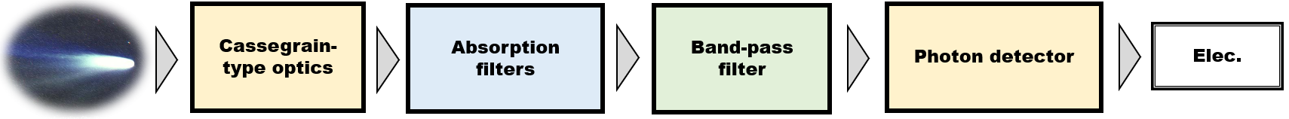

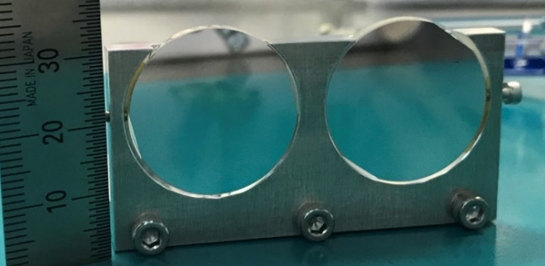
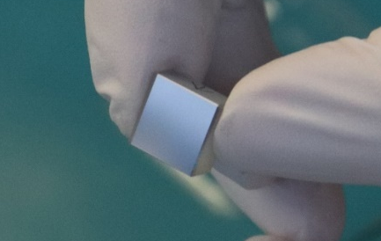
Optics (Al+MgF₂ Mirror) and Bandpass filter
Sample mirror
BPFs (lab. Experiment)
R=65%@121.6nm
Trans.=7~9%
Al+MgF2
Al
FWHM~10nm
1st and 2nd mirror (BBM)
Reflectance of sample mirrors. (coatings test)
Transmittance of BPF (BBM)

Slide 5
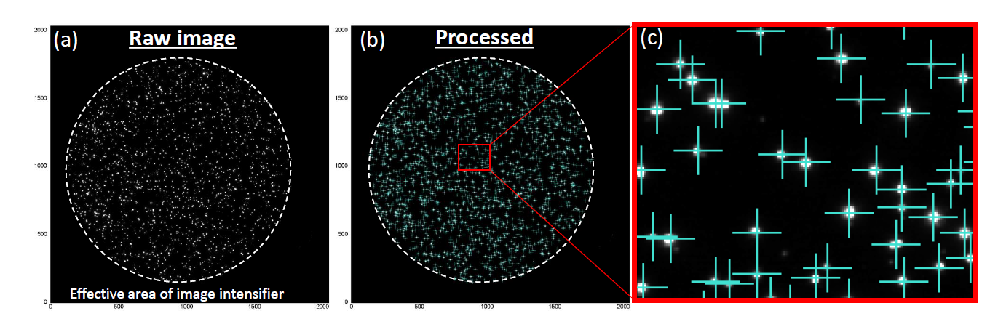
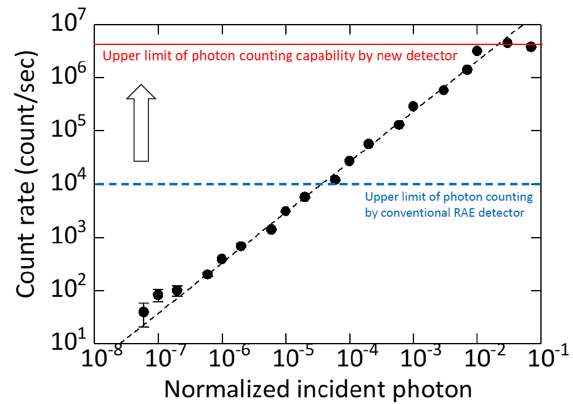
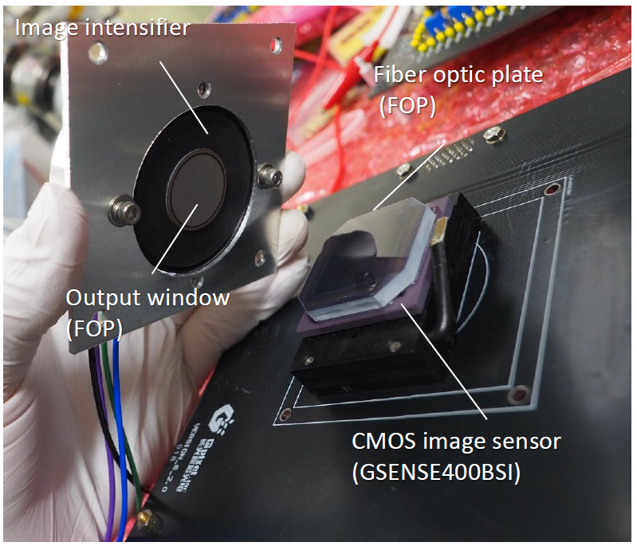
Photon detector (Image Intensifier + FOP +CMOS)
Vis. image
CMOS image (1 flame)
Composite image (50 flames with centroid calc.)
UV
50fps CMOS image
<30,000 counts/flame
50 x 30,000 = 1.5Mcps
x150 (MCP analog system)

Slide 6
Ly-alpha brightness?
Brightness range
  JFC: 0.05~10 kR
  LPC or Hypobaric: 0.5~ 500 kR
Comet | Period [yr] | B max. [kR] | Norm. B min. [kR] | Norm. B max. [kR]
2P/Encke | 3.3 | 18 | 0.20 | 10.4
46P/Wirtanen | 5.44 | 0.046 | 0.06 | 0.055
103P/HARTLEY2 | 6.47 | 0.15 | 0.003 | 0.003
21P/G-Z | 6.55 | 12.7 | 4.3 | 15.6
67P/C-G | 6.57 | 0.2 | 0.33 | 0.33
1P/Halley | 75.3 | 99.5 | 6.2 | 70.2
Y1/Bennett | 1678 | 40 | 12.5 | 50.2
C/1996 B2 Hyakutake | ~0.11My | 10 | 11.5 | 11.5
C/1995 Hale-Bopp | ~0.90My | 12 | 9.94 | 9.94
P1/Garrardd | N/A | 0.1 | 0.27 | 0.26
E1/Kohoutek | N/A | 500 | 0.62 | 16
C/2013 US10 Catalina | N/A | 100 | 70 | 70
C/1975 V1-A (West) | N/A | 150 | 22.4 | 22.4
HI shall be optimized for 0.5-500k
(note1) IPM Ly-α: 0.2-0.7kR
(note2) D/H ratio: 0.0001~0.001

Slide 7
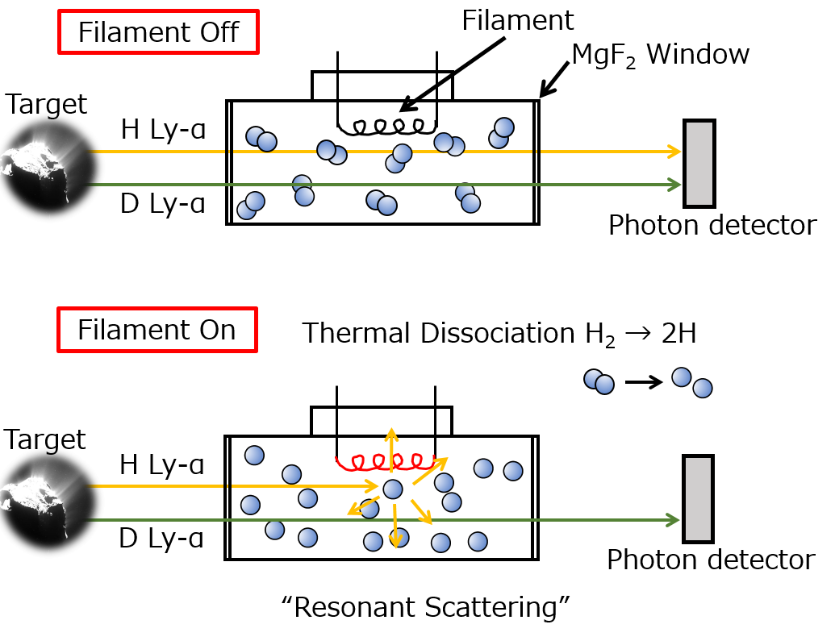
Absorption filter
Glass cell filled with H2 (or D2).
H (or D) Lyman-α from the coma can be deduce separately.
Line width (Doppler broadening) can also be deduced.
High temp. target
Low temp. target
Slope → Temperature
Fil. temp.
= low
High temp. target
Photon counts on the detector
Fil. temp.
= mid.
Low temp. target
Fil. temp.
= high
Fil. power
W₀
W₁
W₂
W₃

Slide 8
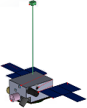
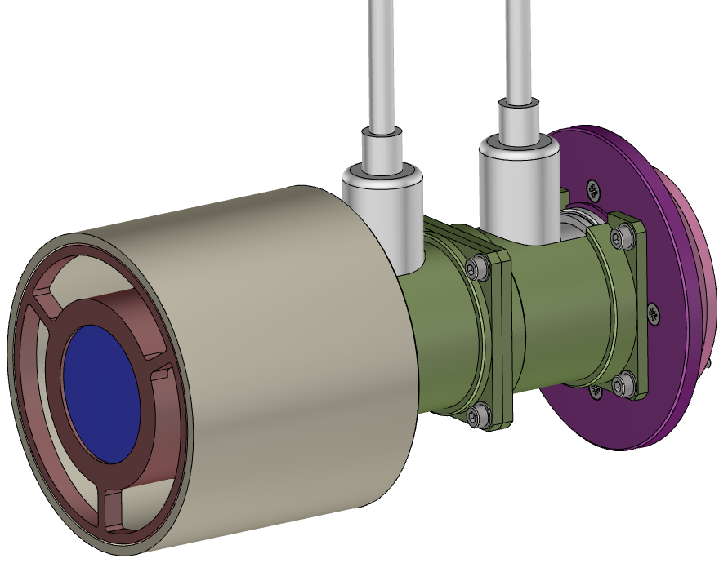
Observation scenarios
Imaging mode (Cruising)
Light-curve mode (Closest approach)
4°=10⁷km (from 1AU)
B1 Velocity
coma
Nucleus
Image
(1pix= 5x10⁴km)
1000km
10⁵~10⁶km
HI FOV
HI FOV
Light-curve
~2kbps
FOV(256x256)
130kB/image
HI FOV

Slide 9
Imaging mode (cruising)
Image data specifications
  FOV: 10⁷ km x 10⁷ km (from 1au)
  Spatial resolution: 0.5-1×10⁵ km (from 1au)
  Volume: 135 kB/Image (incl. header)
  Acc. : 1-1000 (TBD) sec/Image
  Obs. Freq.: 0-2(TBD) obs./month
Science targets
  Spatial structures related to…
    Upward/Downward for sun
    Nucleus structure and rotation
    Optical thickness
  H₂O production rate
  Heliocentric distance dependence of various parameters.
4°=10⁷km (from 1AU)
coma
FOV(256x256)
130kB/image

Slide 10
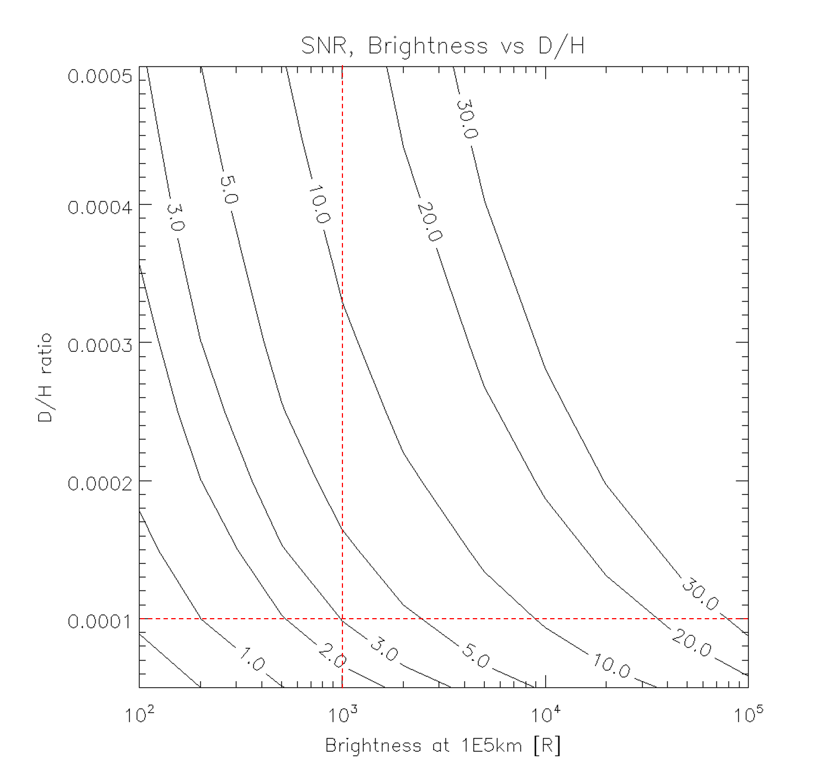
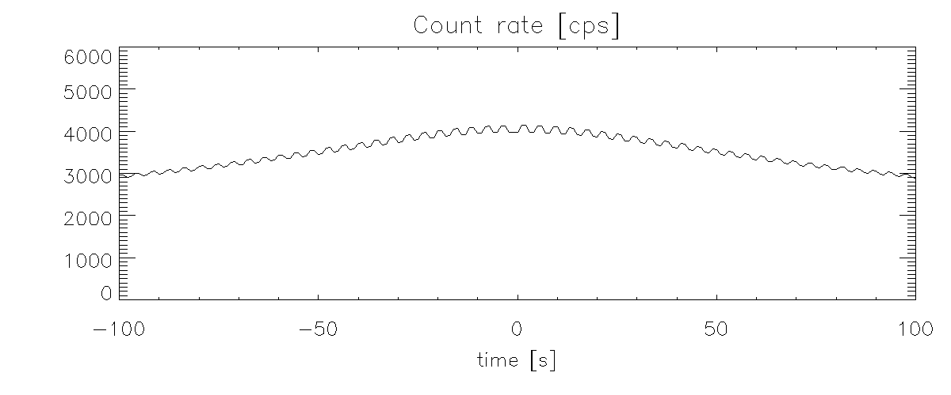
Light-curve (photon counting) mode
Photon counting along the B1 trajectory
H, D filters on/off (cyclically) → D/H ratio.
S/N: ~5 (1P/Halley case, D/H=1e-4)
B1 Velocity
SNR, Brightness vs D/H
Nucleus
V = 20km/s
+/-150s obs. at C.A.
90% abs. for H and D filters
(Optically thick for H Ly-a)
1000km
10⁵~10⁶km
HI FOV
HI FOV
baseline
1p/Halley
Count rate along B1 trajectory (ex. v=20km/s, D/H=5E-4)
D/H ratio
HI FOV
D Cell off
D Cell off
D Cell on
baseline
D Cell on
Brightness at 1E5km [R]

Slide 11
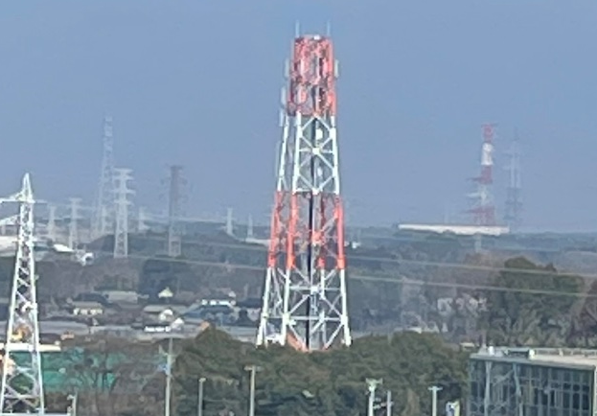
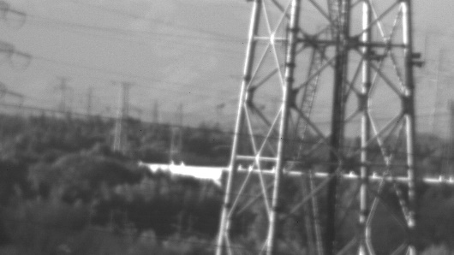
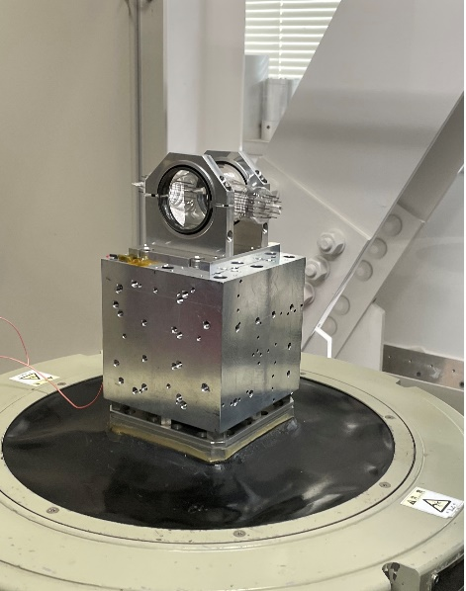
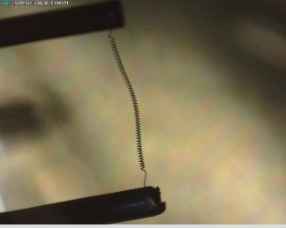

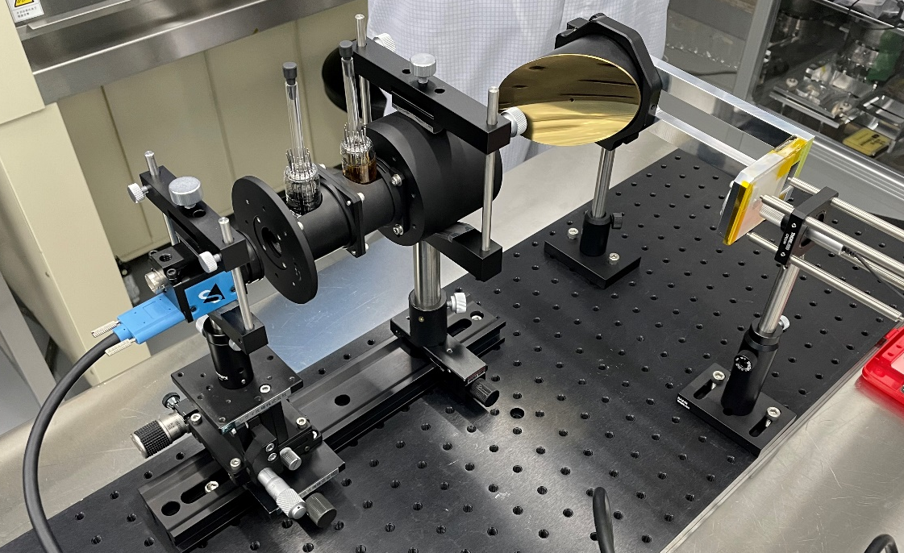

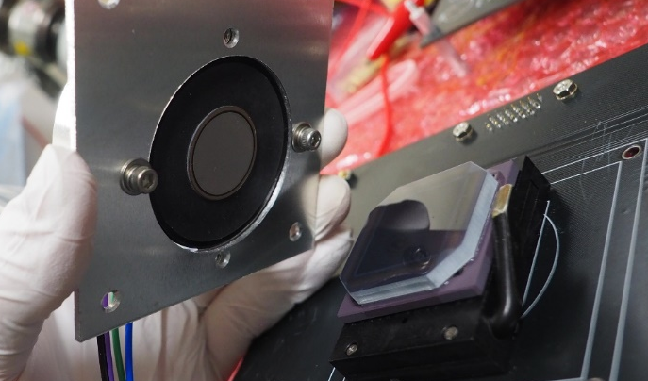
Development status (BBM activities)
3 mm
Filament
Test image (iphone12mini)
Test image (through BBM optics)
Test mirror
VT (cell BBM)
Electronics functional test (BBM)
HI optics
Cell(s)
CMOS
Image Intensifier
I.I. attachment with FOP and CMOS (GSENSE)
Optical test (BBM)

Slide 12
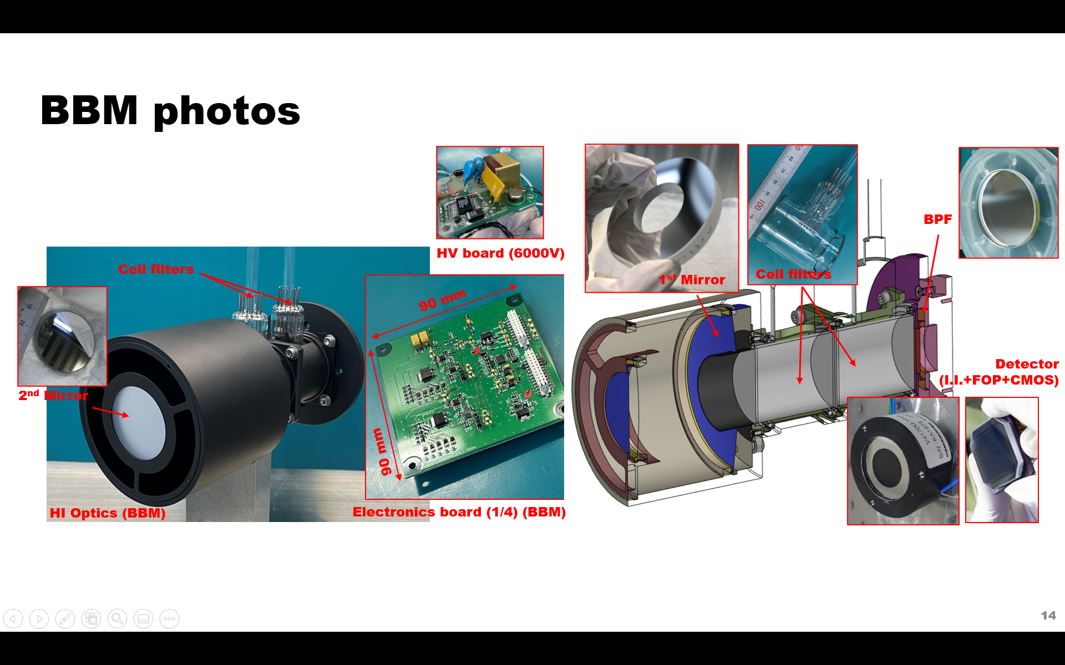
Summary
HI on B1 spacecraft
  HI (Hydrogen Imager) will make a Ly-alpha (121.6nm) imaging of comet coma.
Science targets
  Activity of the LPC.
  D/H ratio and H temperature.
Current status
  Basic design (hardware, software) definition.
  Components BBM evaluation.
  Feasibility study for various targets with coma mode calculations.

