Slide 1



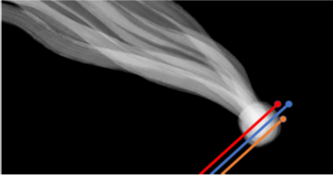

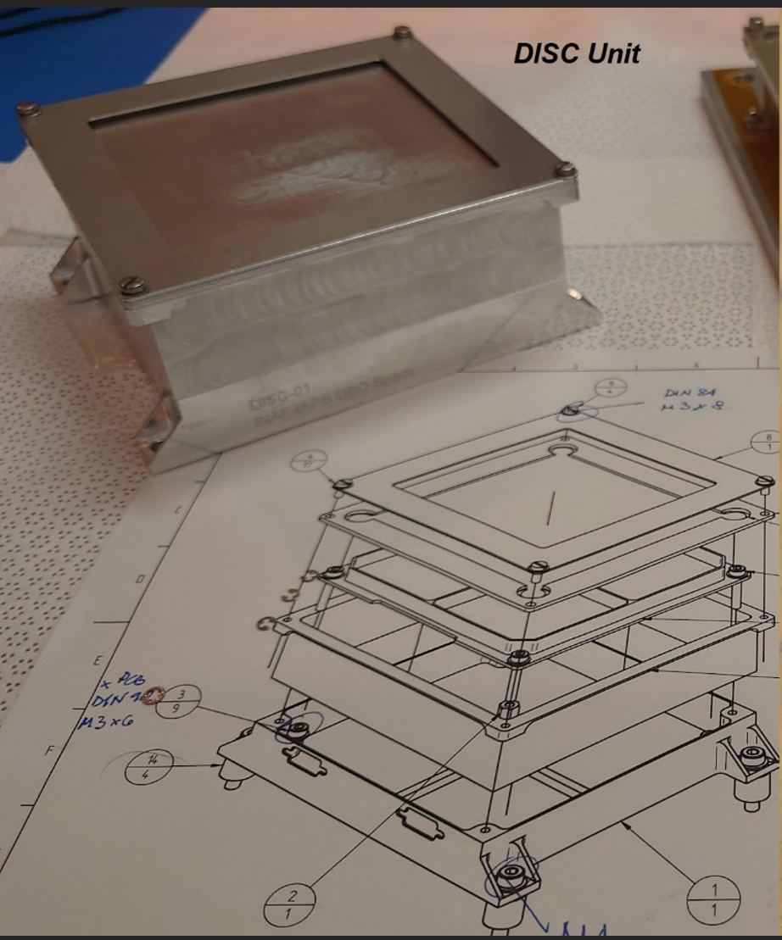
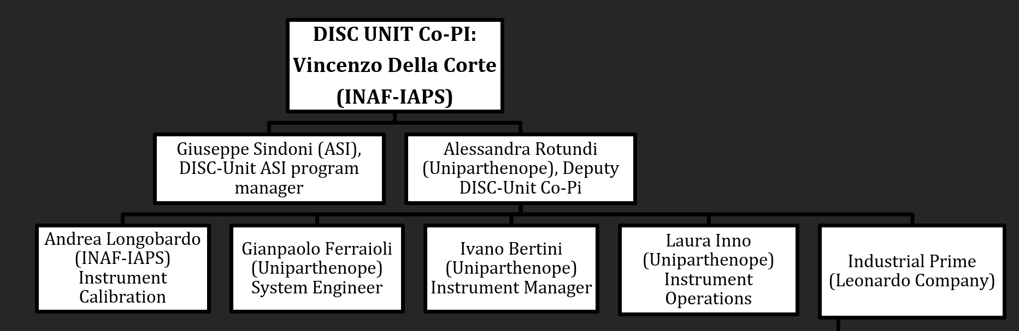
DFP-DISC (Dust Impact Sensor and Counter)
Vincenzo Della Corte (INAF IAPS) on behalf of DISC Team
DISC is the DFP dust sensor (2 units 1 on S/C A and1 on S/C B2) devoted to characterize in situ the cometary dust environment.
DFP-DISC Team

Slide 2
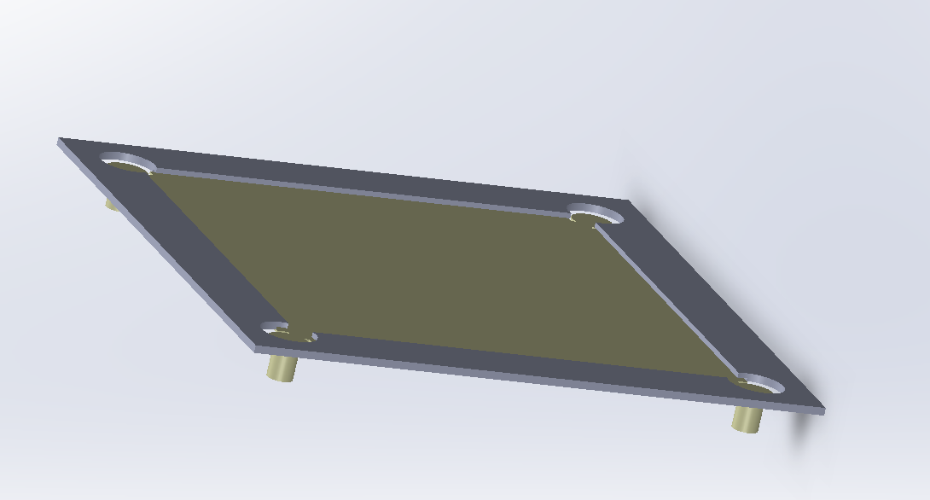
DFP-DISC working principle
DISC sensing element: a thin (0.5 mm) Al squared plate equipped with piezoelectric (PZTs) sensors underneath.
A particle impact on the sensing plate induces flexural (Lamb) waves on the Al plate that are detected by the PZTs.
The maximum displacement of the PZT crystals produces an electric potential directly proportional to impacting particle momentum.

Slide 3

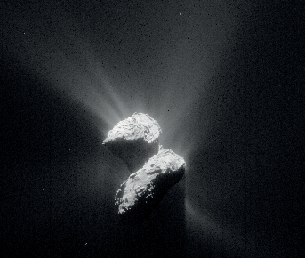
DFP-DISC measurements
Cometary dust particles
Sun
DISC
S/C A or B2
S/C speed direction
Measurement of individual dust particle physical properties:
  Size 1 – 200 micron
  Momentum 10⁻⁴ – 10⁻¹⁰
  Rate max 200 particles/s
DISC units will be mounted on both S/C A and S/C B2 of Comet Interceptor and will determine:
  Dust mass distribution
  Particle tensile strength (elastic wave signal analysis)
  Dust distribution in the coma on disentangled temporal and spatial scales

Slide 4
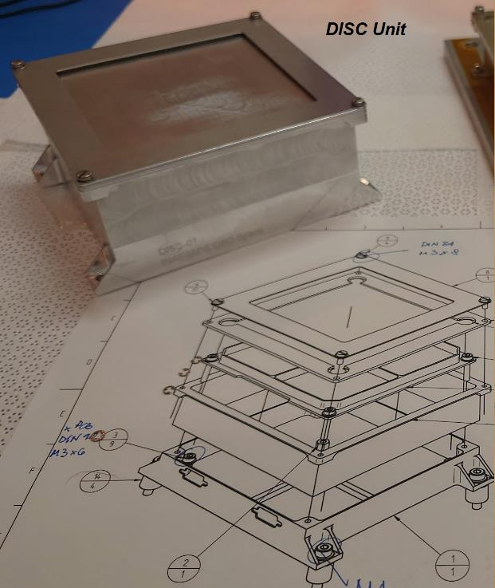
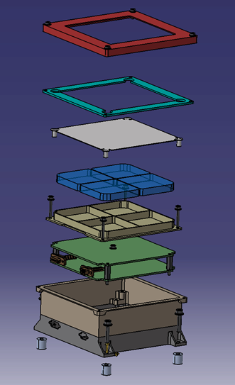
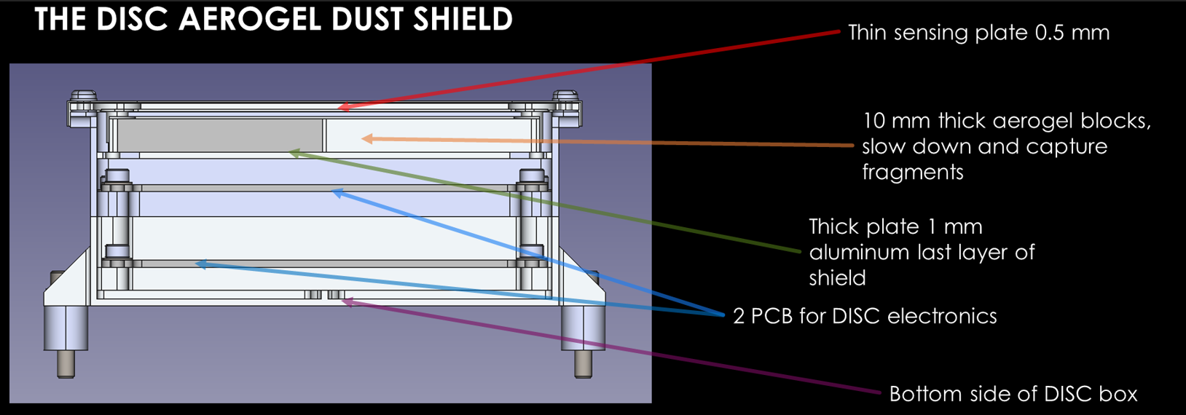
DFP-DISC UNIT
Mass [kg] | Power [W] | Envelope [mm]
0.450 | 2.3 | 126x116.5x54

Slide 5
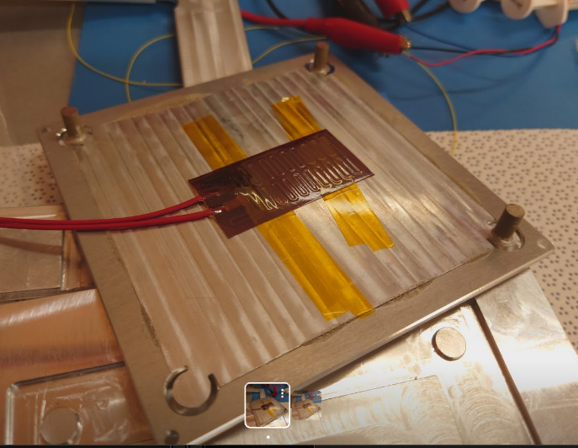
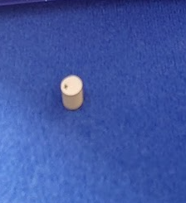
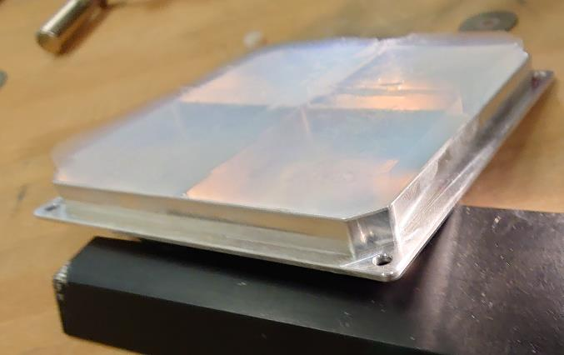
Activities on DFP-DISC Unit breadboard
Tests with real and simulated dust impacts (EXPRO dust impact effect study):
  passive breadboard used to test performances on internal dust shield;
  preliminary sensing plate assembling with spare PZTs to test an active breadboard in laboratory.

Slide 6
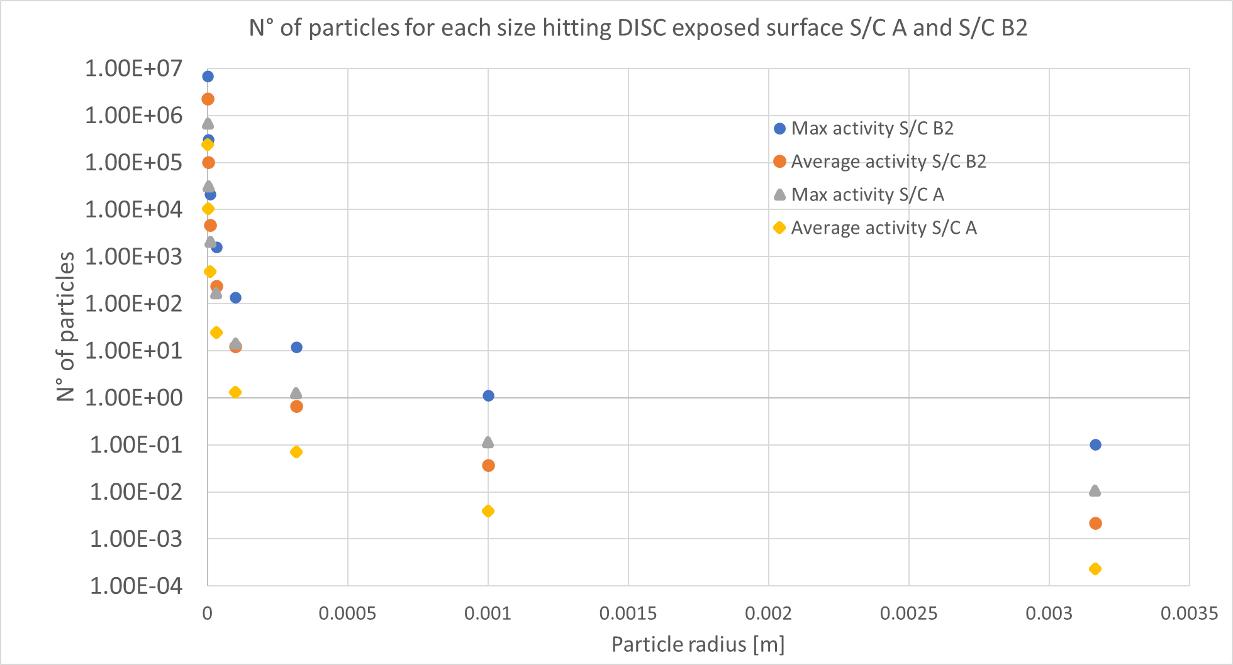
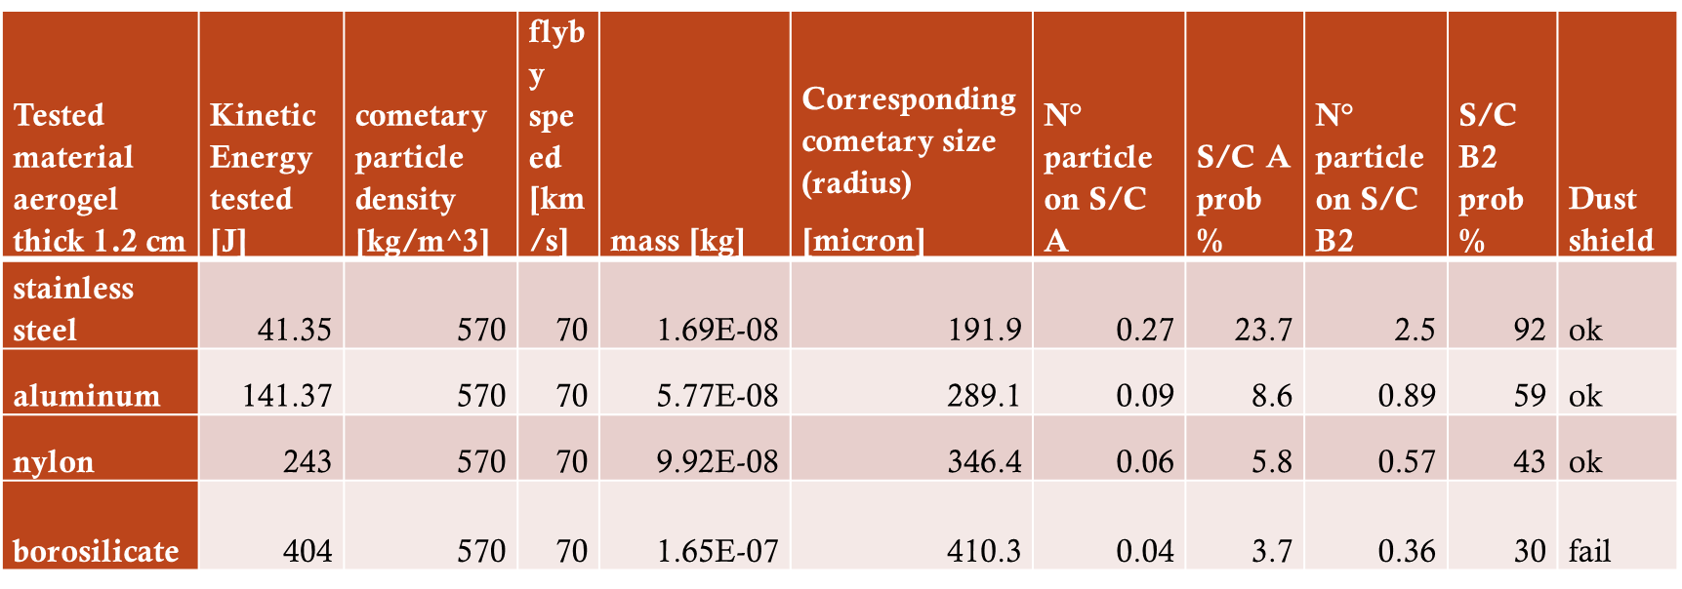
Expected dust environment and dust hazard 1/2
Max particle size with 10% probablity (avg activity):
  S/C A 0.4 mm radius
  S/C B2 0.75 mm radius
After tests the dust shield design was improved;
Expected performances:
  10% failure probability for S/C B2

Slide 7
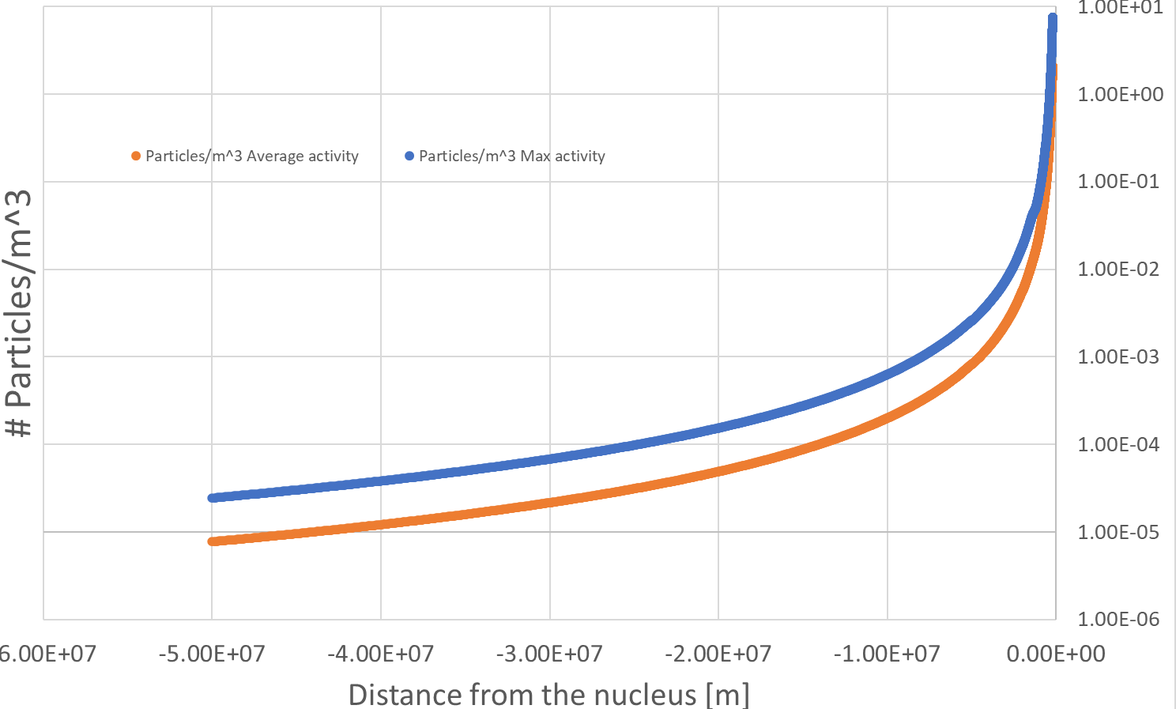
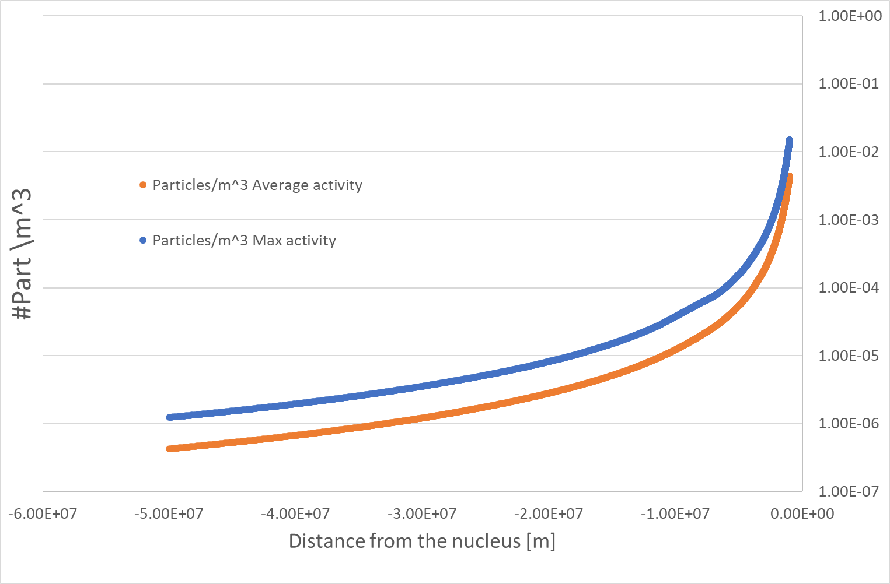
Expected dust environment dust hazard 2/2
For DISC aboard S/C B2 we estimated approximately 10⁶ and 5x10⁵ particle detections for the maximum and average cometary activity, respectively.
For DISC aboard S/C A we expect a factor of 10 fewer events, with maximum rates lower than 200 particles/s for DISC on B2

Slide 8
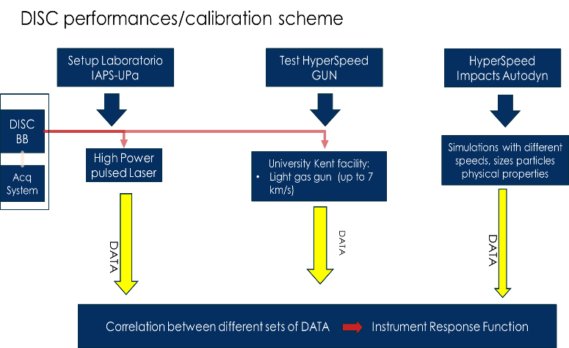
DFP-DISC calibration/performance check approach

Slide 9
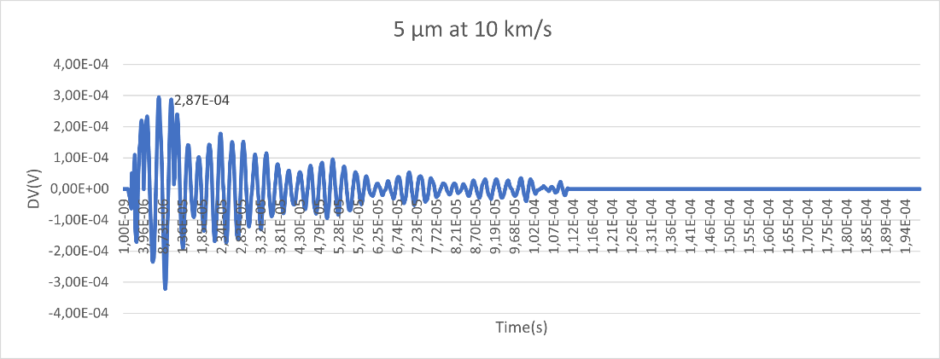
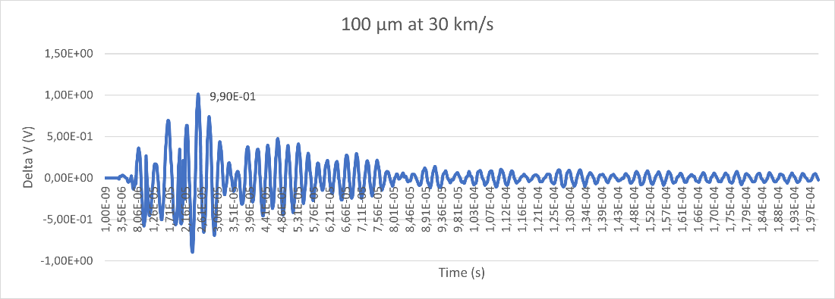
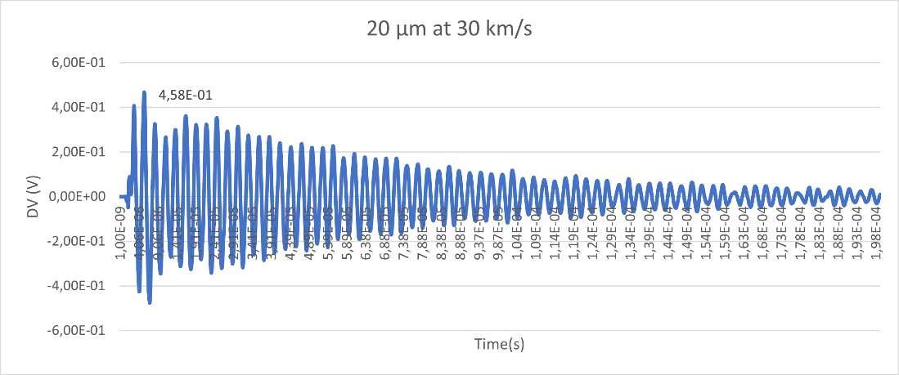
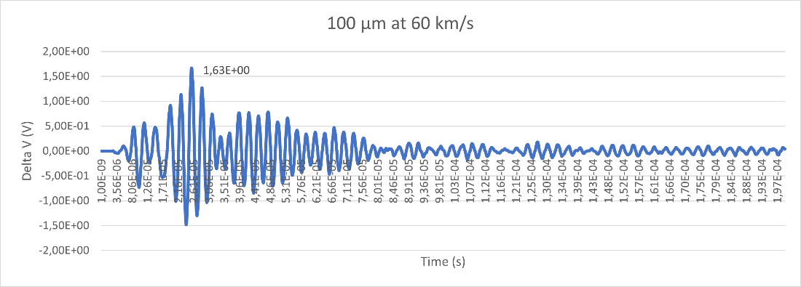
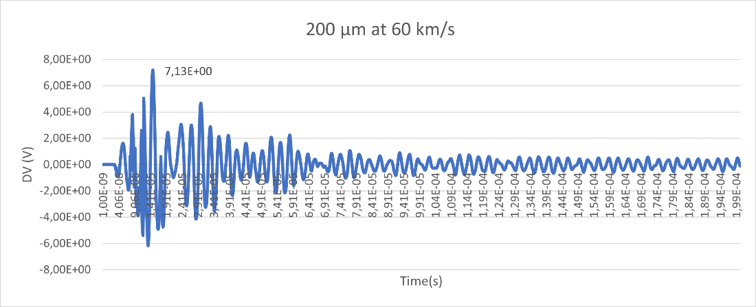
Expected signal/performances simulated 1/2
SPH + FEM + coupled simulations performed to evaluate signal level from expected particle impacts
PZTs signal evolution for different impacting particle parameters: speed, size, density
From these simulations indication on the DISC design will be retrieved in advance:
  Extinction Time => maxim impact rate
  Signal Amplitude => Proximity Electronics fine tuning

Slide 10
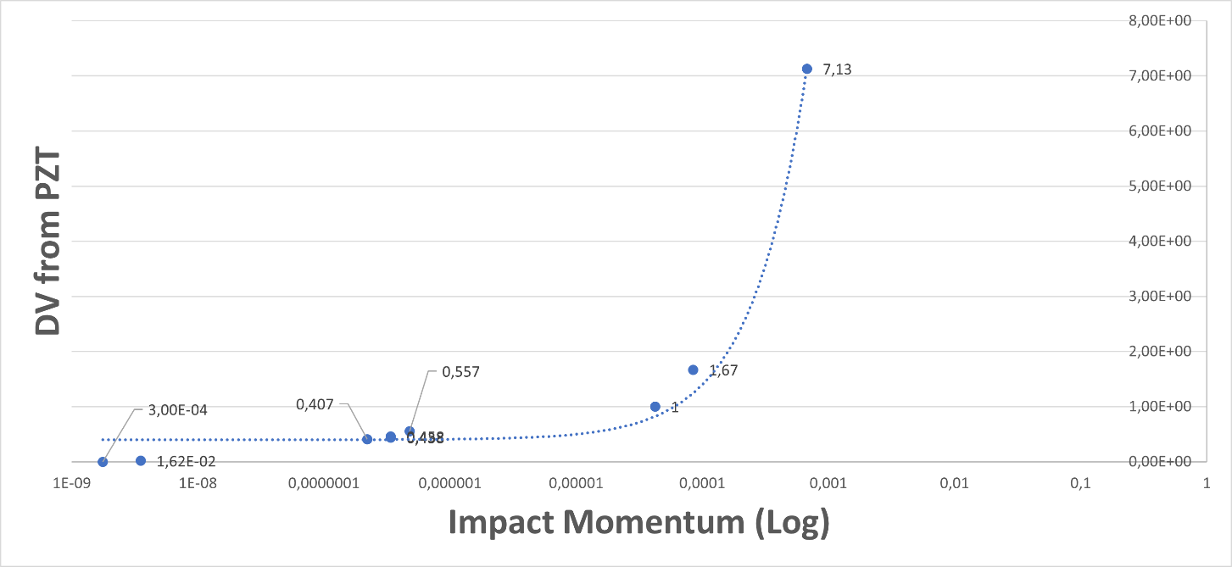
DFP-DISC response function obtained by simulations: signal values retrieved from simualation vs impacting particle momentum
Expected signal/performances simulated 2/2

Slide 11
Expected signal/performances high power laser 1/2
Laser-simulated impacts will be performed using an experimental setup available at the INAF-IAPS laboratory, in Rome.
The approach take advantage of the late stage equivalence (Pirri, 1977): by choosing appropriate laser intensity, beam radius, and pulse duration, the effect of hypervelocity particles impacting on DISC can be reproduced.
Particle velocity/radius ranges simulated by a Nd:YAG laser for different particle densities
Momentum and mass ranges for: particles simulated by a Nd:YAG laser (gray); and real particles shot with by LGG (magenta) and VdG (green).

Slide 12
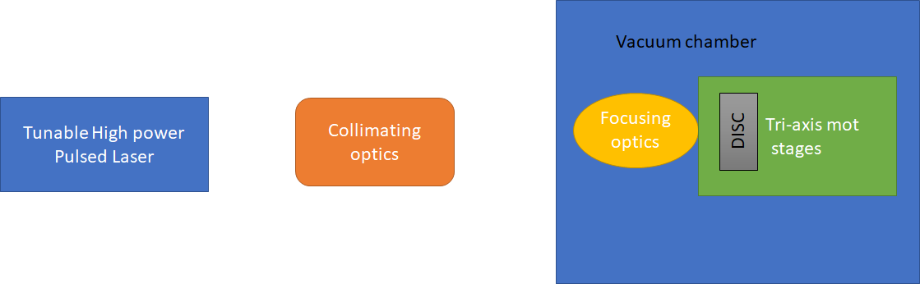
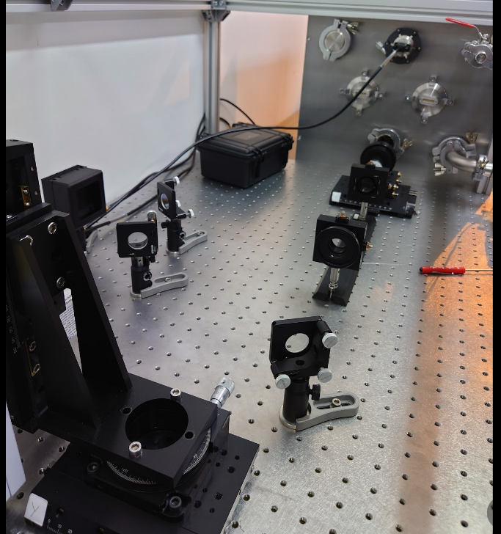
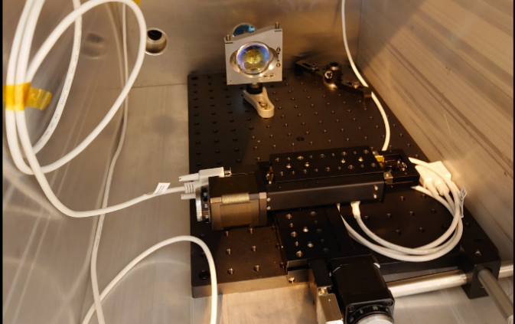
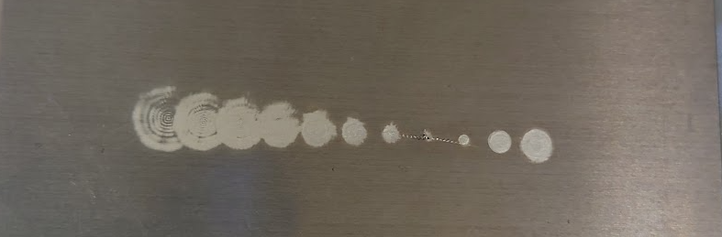
Expected signal/performances high power laser 2/2
Laser pulsed impact simulattion scheme
Collimating optics outside the vacumm chamber
3-axis stage inside the vacumm chamber
Laser shot tests at different distances on DISC
sensing plate

Slide 13
Conclusions
DFP-DISC has a high heritage from the GIADA Impact Sensor sub-system, succesfully flown onboard Rosetta/ESA space probe.
The additional DFP-DISC internal dust shield was tested and performances suitable for the expected cometary dust environment.
Industrial partner selection for the next phases of DFP-DISC development is on-going, contract will start on the beginning November 2022.

