Slide 1
Entire Visible Sky
EnVisS
Overview and updates
Vania Da Deppo (CNR-IFN Padova Italy) on behalf the EnVisS Team
Comet Interceptor Full Team Meeting
Oxford
6-8 July 2022

Slide 2
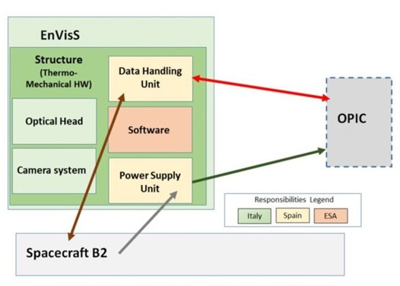
EnVisS Consortium
ILS Vania Da Deppo CNR-IFN Padova, Italy
Co-ILS Luisa M. Lara IAA-CSIC Granada, Spain
Instrument Manager Vincenzo Della Corte, INAF-IAPS, Roma, Italy
System engineering/project management is up to Leonardo SpA, Italy
PHU and DHU are being realized by IAA/Sener, Spain
Software will be developed by industry under an ESA contract with the supervision of Aalto University, Finland. ​

Slide 3
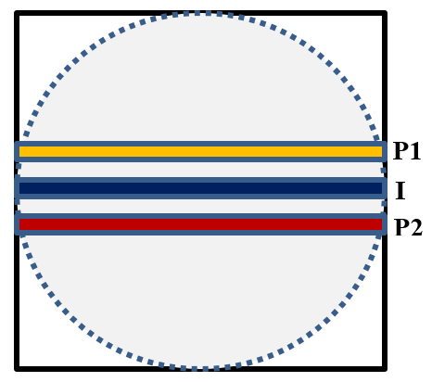
EnVisS camera concept
The EnVisS camera is conceived to study the comet dust environment, including its polarimetric properties, in the visible wavelength range.
The study will be conducted through the full fly-by encounter from an advantageous point inside the coma itself.
Being the instrument mounted on the B2 rotating spacecraft, a rotational push-broom or push-imaging technique can be adopted.
The full sky view will be re-constructed acquiring slices of the sky that will be then stitched to form the full image.
Filters directly bonded to the detector, or mounted very near to it, can be foreseen to acquire images in different colors/polarization. This solution allows for a compact, low mass and low complexity camera.
Axis of rotation
Scene motion
Illustration of the EnVisS full sky scanning concept
Schematics of the filter strip images on the detector

Slide 4
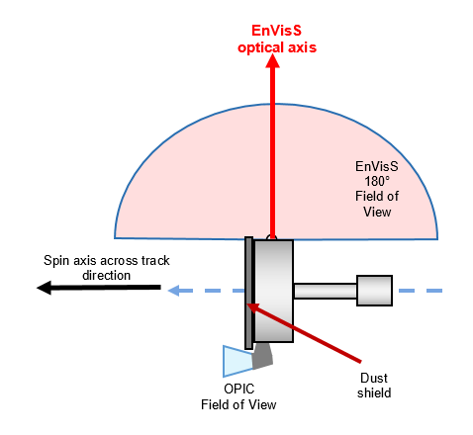
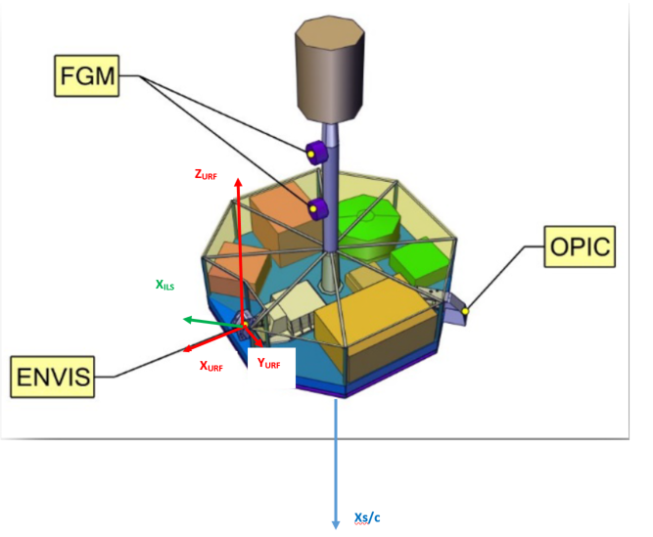
EnVisS accommodation on B2
The optical head’s axis is 90° to the spin axis.
The probe spin-axis will be pointing to the comet nucleus for most of the time, except at close approach when the comet nucleus will fall inside the camera FoV
(e.g. fly-by @ 10 km/s 2.8 hours before CA, fly-by @ 70 km/s 24 min before CA)
Requirements from EIDA-B2:
spin rate 4-15 rpm (spin period 4 to 15 s) → basel. 4 s
0.9-1.2 AU heliocentric dist.
fly-by velocity 10-70 km/s
solar aspect angle 45-135°
closest approach distance 250-500 km.
Motion of the scene/along track direction
Spin axis/cross track direction

Slide 5
EnVisS Requirements
Wavelength coverage 550-800 nm filter
1 broad band (intensity) filter
2 polarimetric filters
SNR 10 Broad band (Intensity)
100 Polarimetric filters
FoV 180°x45° (fixed)
180°x360° (dynamic)
Detector CMOS 2kx2k - 5.5 micron px size
Scale factor 0.1°/px
Entrance aperture 1.23 mm
F/# 2.8
Telecentricity < 4° (at the edges of the FoV)
Distortion law F-theta
Distortion value < 6%

Slide 6
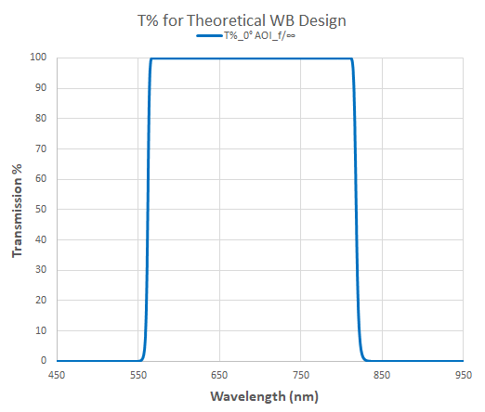
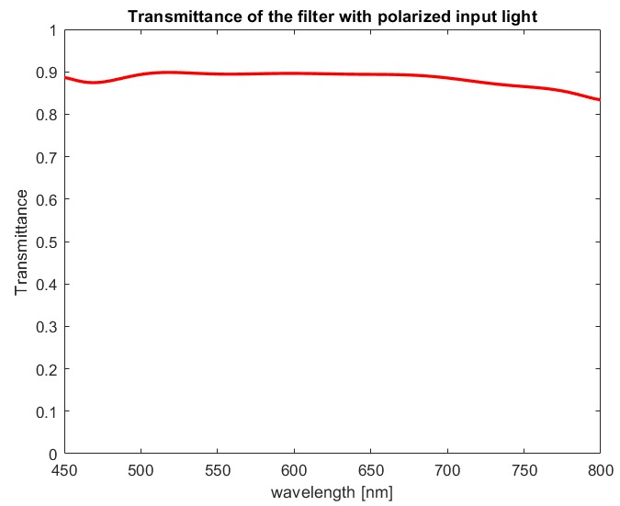
EnVisS filters characteristics
For EnVisS to study the comet dust and its polarization, 3 broad-band filters are foreseen:
one broadband (I) filter centered on the detector
two polarimetric filters (P1 and P2) with polarization axis oriented at 45° one to the other
The wavelength range for all the filter strips has been selected to be 550-800 nm.
Filter strip size: 20 x 2048 pixels (2°x180° FoV)
MTF matches with 2x2 px (angular resolution 0.2°)
Broadband non-polarizing filter transmission
Polarizing filter transmission for unpolarized and p-polarized light
Axis of rotation
Scene motion
Schematics of the filter strips on the detector

Slide 7
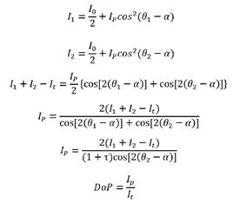
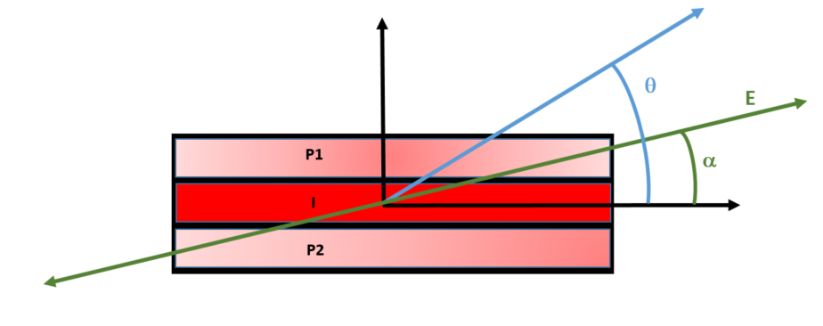
Polarization measurements
Derivation of the polarization angle and of the linear degree of polarization of the incoming radiation:
one intensity measure (I_{t})
two polarimetric measures (I₁ and I₂)
To:
I_{p} (DoP) and α.
Schematics of the filter strips for the filter strip assembly with the indication of the angle considered for the equation calculations

Slide 8
Acquisition modes
Low-resolution mode, nucleus at the edges of the FoV and not resolved integration time depending on the coma signal level and desired SNR
High-resolution mode, nucleus in the FoV at closet approach resolved (integration time between 2 ms and 7.5 ms to avoid smearing due to rotation)
Axis of rotation
Scene motion

Slide 9
EnVisS operation
A flexible approach has been devised to allow obtaining the required SNR for each type of observation.
In the direction of the apparent motion of the scene, the signal from the coma is not expected to change too much and a high spatial resolution is not needed from a scientific point of view.
The integration time for each filter strip can be tuned allowing for some smearing in the direction of the rotation of the scene.
The spatial resolution is retained in the across track direction and assure a sampling of the comet phase function every 0.2° as required.
This approach also allows for an adjustment of the exposure time if the radiance of the coma is different from expected.
Further pixel binning, or co-adding of the images over different rotations, could be considered if the signal should be extremely low.
Axis of rotation
Scene motion
Schematics of the filter strips on the detector

Slide 10
Coma radiance and SNR
Coma radiance depends on the activity of the selected Comet Interceptor target comet
Comet Interceptor is designed to survive to a Halley-like activity, thus we used the Halley dust coma radiance, measured by Giotto, as reference:
  column integrated radiance at 0.96 AU is 6.3 10⁻⁶ W/(m² sr nm), at 1000 km and a line of sight at 37° from the nucleus.
Increase the exposure time allowing smearing, lower spatial resolution, in the direction of the scene motion
Filter | Integration time (ms) | Binning | Spatial_resolution (°) | SNR
Intensity | 35 | X2 (CT) | 3.5 (AT) 0.2° (CT) | 15
Intensity | 35 | X14 (CT) | 3.5 (AT) 1.4° (CT) | 40
Polarimetric | 500 | X2 (CT) | 45 (AT) 0.2° (CT) | 50
Polarimetric | 500 | x10 (CT) | 45 (AT) 1 (CT) | 100
Axis of rotation
Scene motion

Slide 11
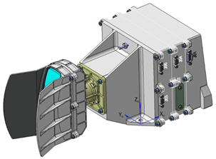
EnVisS status and BB activities
EnVisS went through the I-PDR process (May/June) and the delta I-PDR will take place in September/October.
Instrument design has changed and matured, a baffle has been added.
Mechanical design has changed mainly to allow to cope with wide operative thermal ranges.
Thermal analysis is still on-going to be completed together with the thermoelastic analysis.
Software requirements are being revised together with OPIC.
Compression demo algorithm are being implemented.
EnVisS instrument present mechanical layout (courtesy of Leonardo SpA)
Breadboarding activities of the subsystems are supported by ESA through EXPROs:
1- DHU and PHU Development
2- Optical Head
3- Overall BB integration and test activities

Slide 12
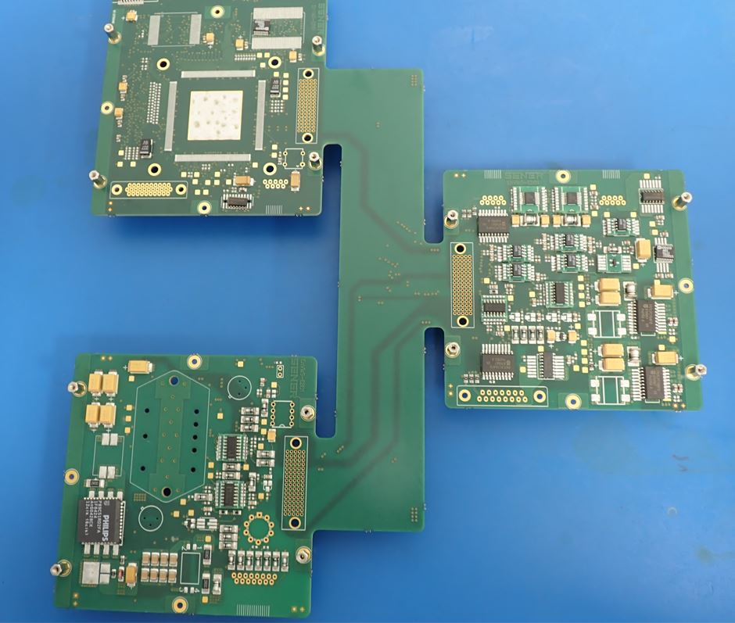
Electronics development @ IAA
DHU/PHU EBB1 - TRL5
Electrical tests on DHU/PHU have been completed successfully with performance within expectation
DHU/PHU EBB2 – TRL 6
Design on-going with End of Electrical and Environmental tests expected in summer/autumn

Slide 13
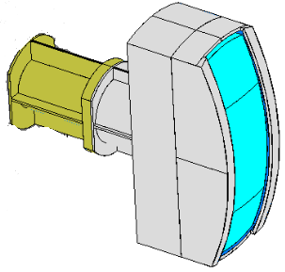
Optical Head @ LDO
A prototype of the EnVisS fish-eye lens optical head will be realized by Leonardo SpA in Florence (Italy).
Optical head design finalized.
Mechanical parts already procured and available.
Procurement of the breadboard optical elements and of the GSE for alignment is ongoing.
The BB optical head will be fully integrated and tested in autumn.
BB Optical Head (courtesy of Leonardo SpA)

Slide 14
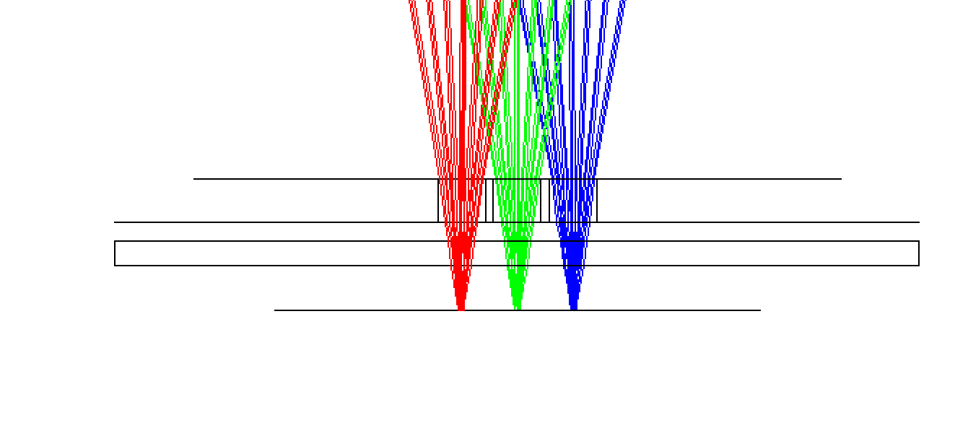
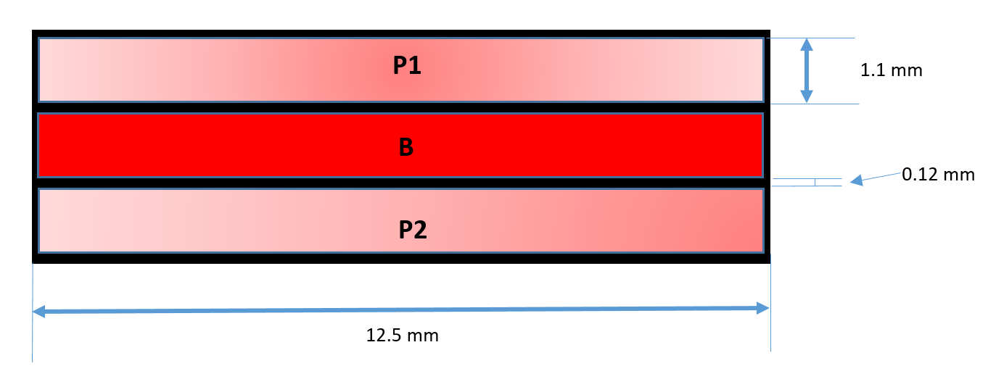
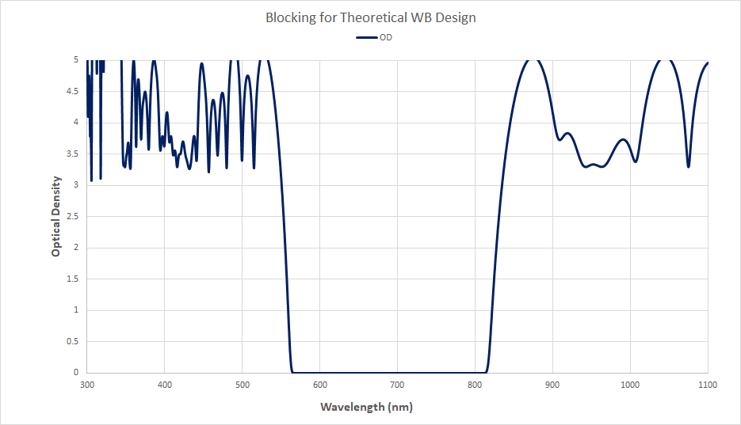
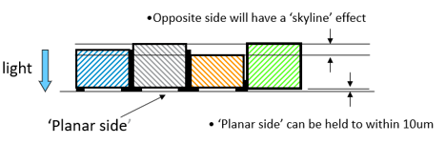
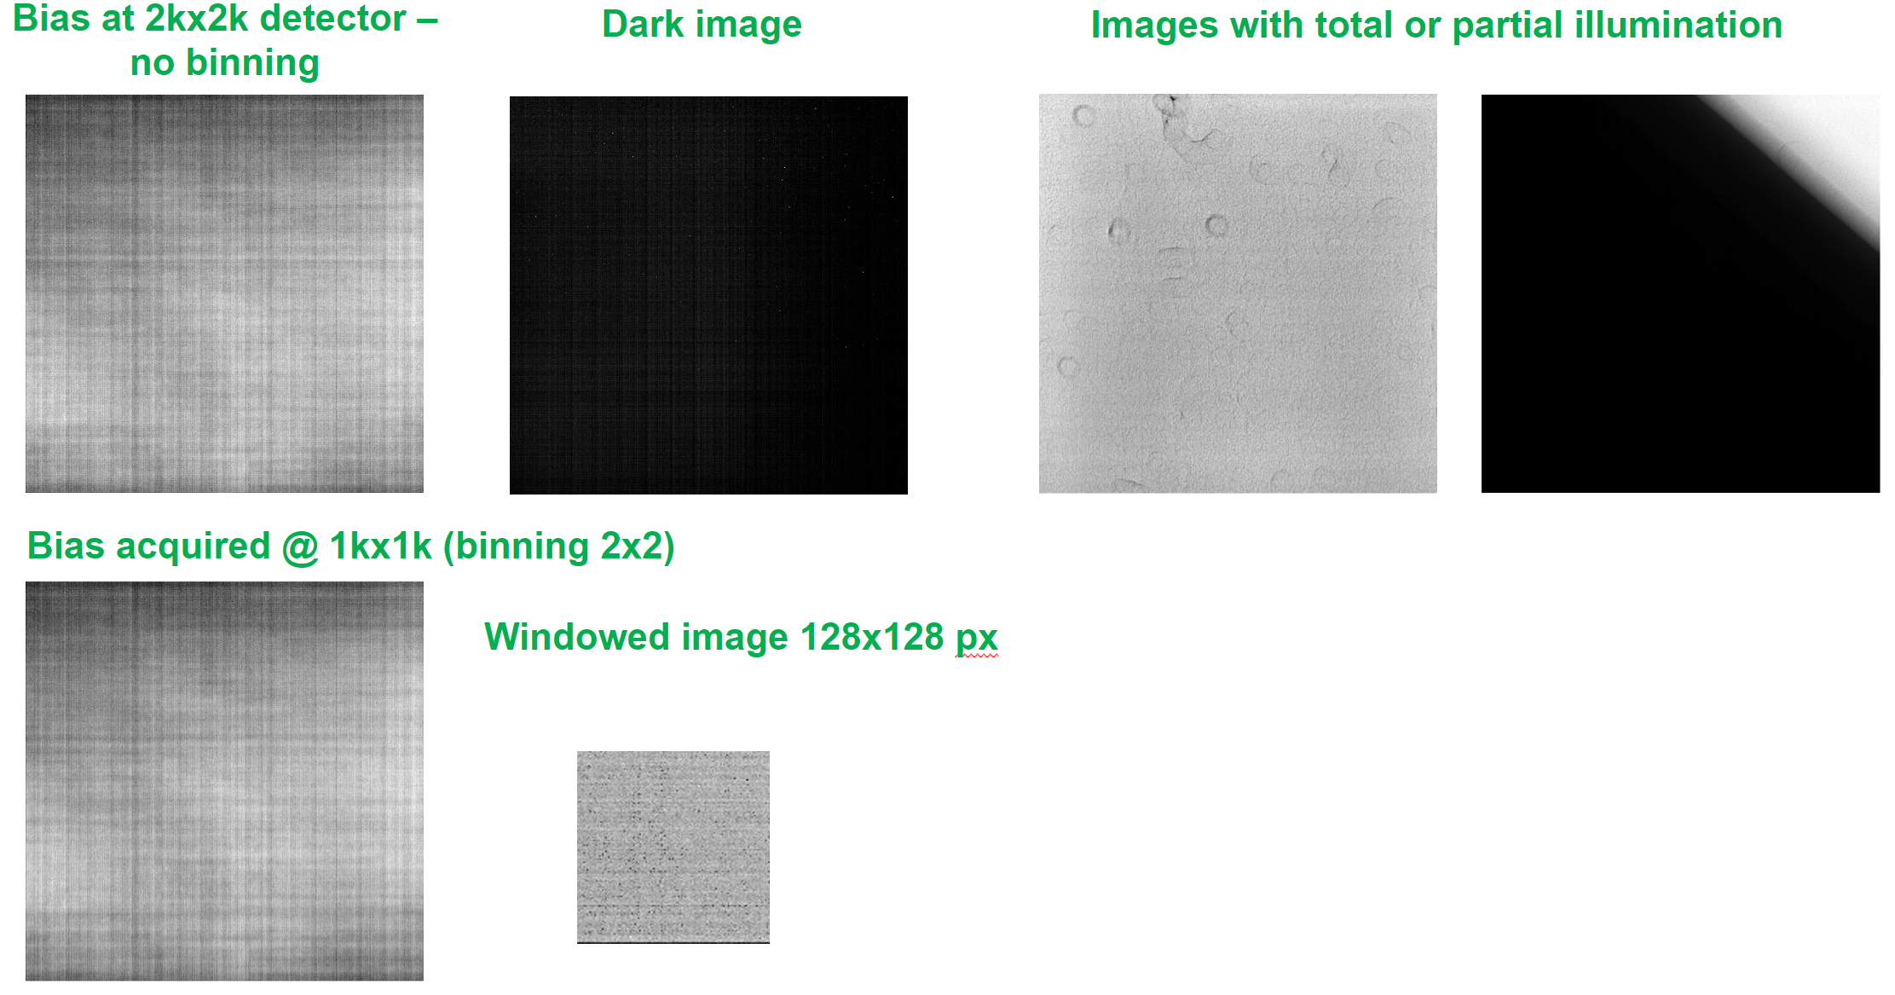
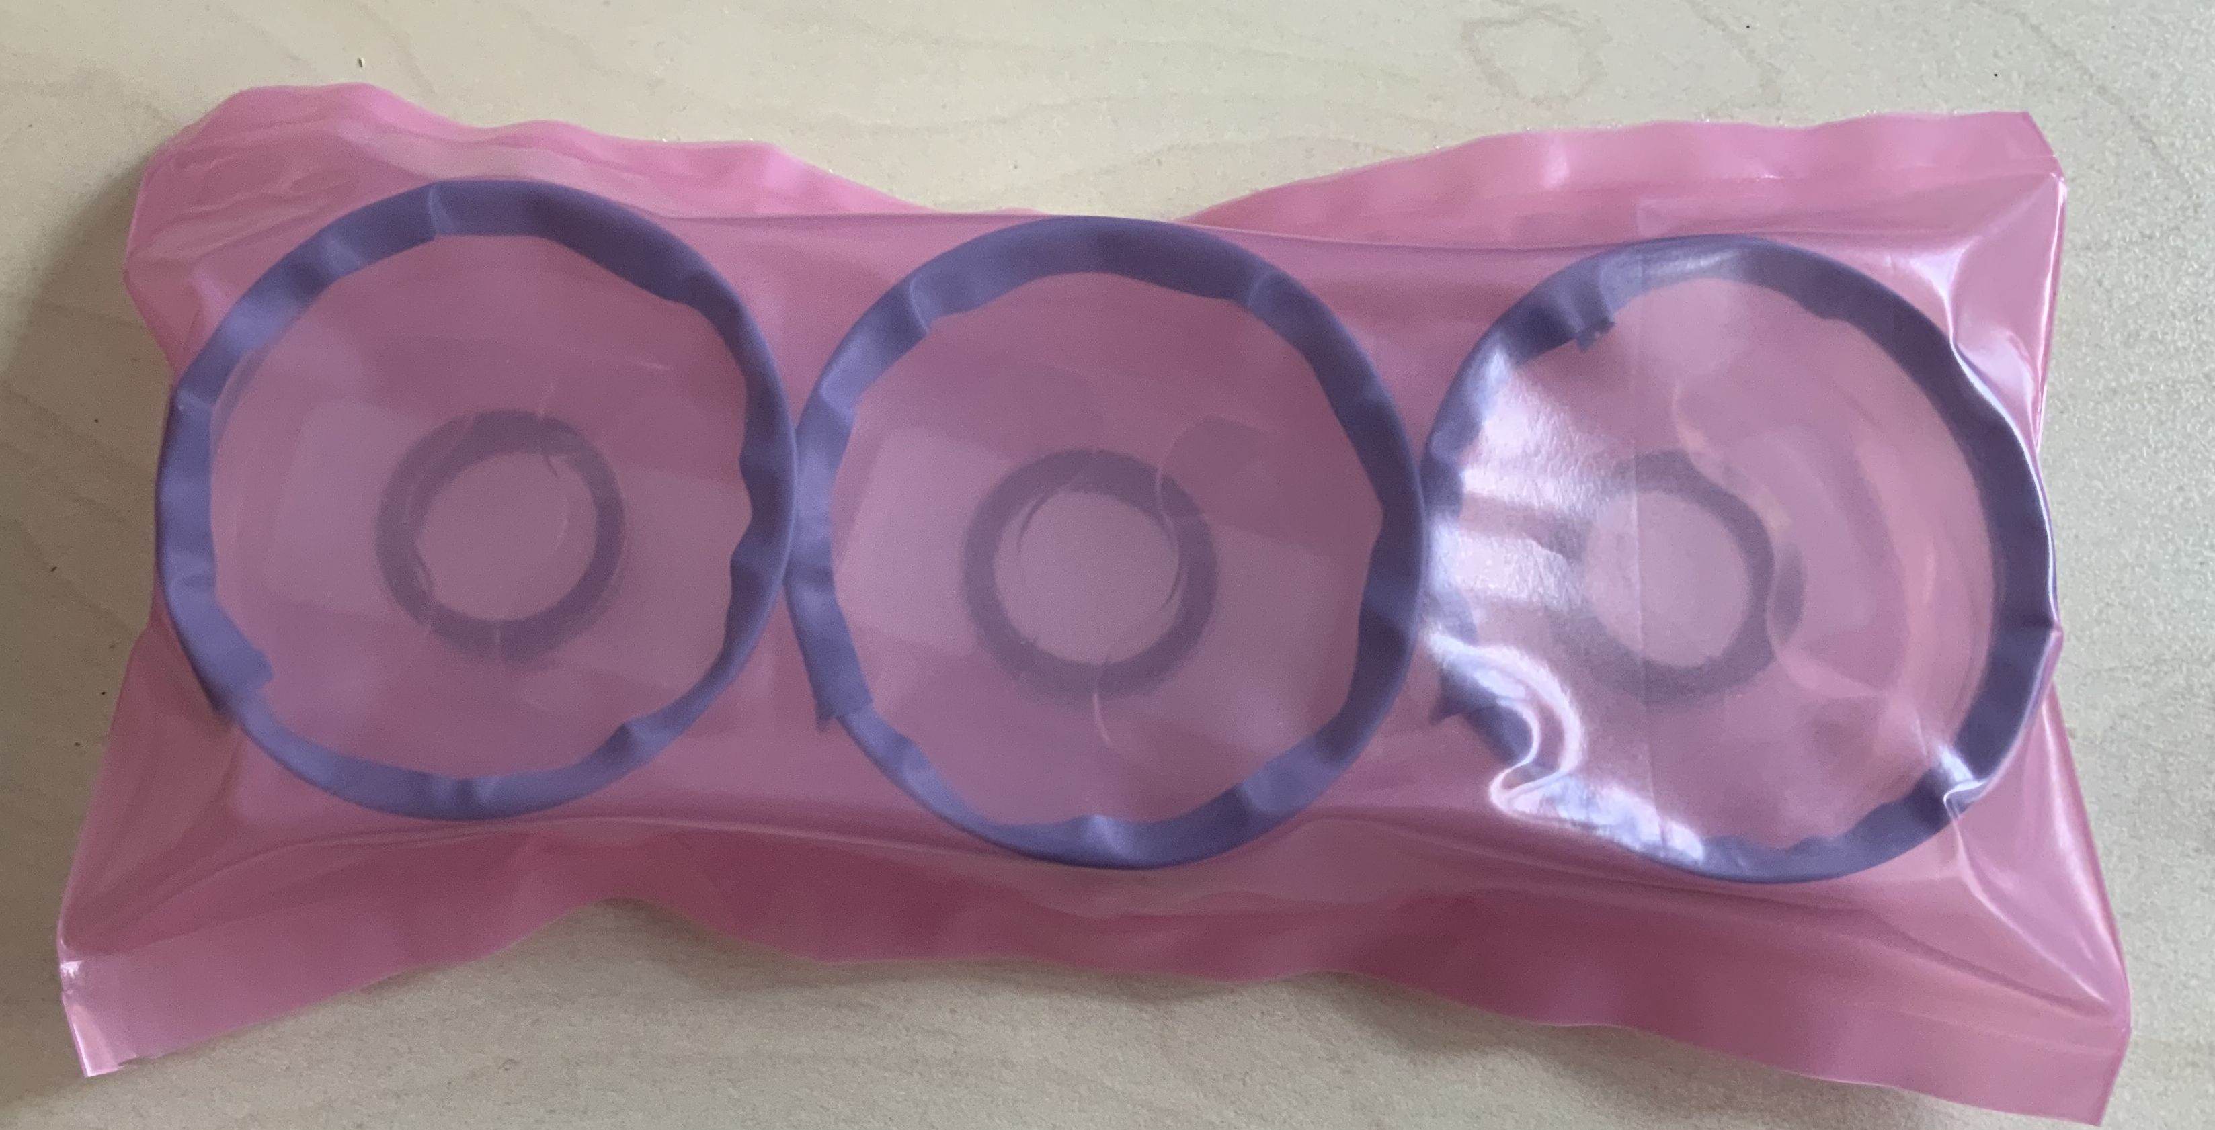
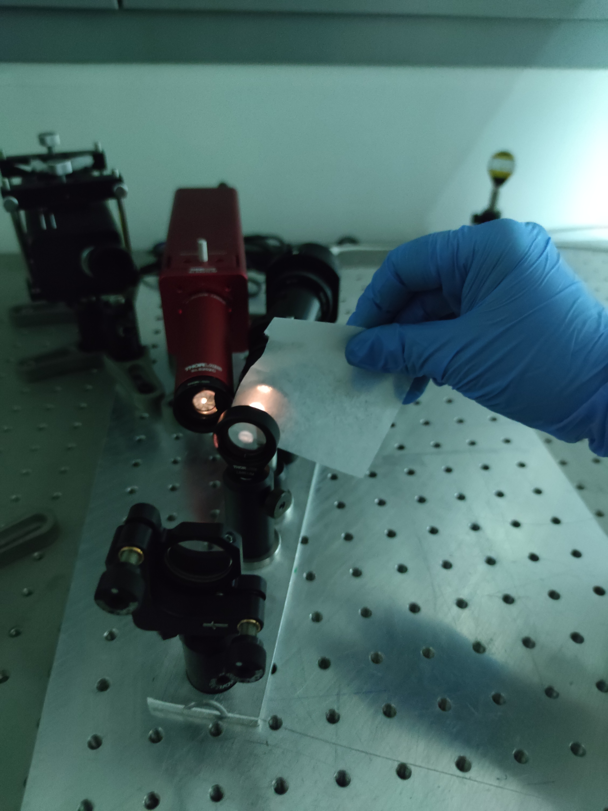
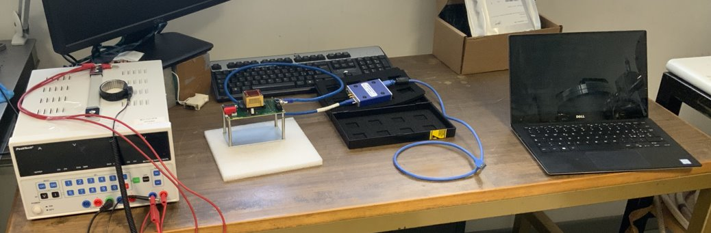
BB activities @ CNR-IFN/INAF
Filter definition
Broadband non-polarizing T and blocking
Schematics of the filter strip
Polarization filters activities
EM 3D-plus detector operation
Polarization filter characterization
Polarization dummy filters procured

