Slide 1
The Comet Interceptor Mission
Presentation to the ESA Solar System and Exploration Working Group
10 May 2022
Comet Interceptor Science Study Team
(in alphabetical order)
Geraint Jones UCL Mullard Space Science Laboratory, UK
Hideyo Kawakita Kyoto Sangyo University, JP
Michael Küppers ESA Study Scientist
Luisa M. Lara Instituto de Astrofísica de Andalucía, ES
Colin Snodgrass University of Edinburgh, UK Cecilia Tubiana INAF-IAPS, Rome, IT Satoshi Kasahara University of Tokyo, JP
and the Comet Interceptor Consortium
@cometintercept

Slide 2
Rosetta
ESA/Christian Stangl

Slide 3
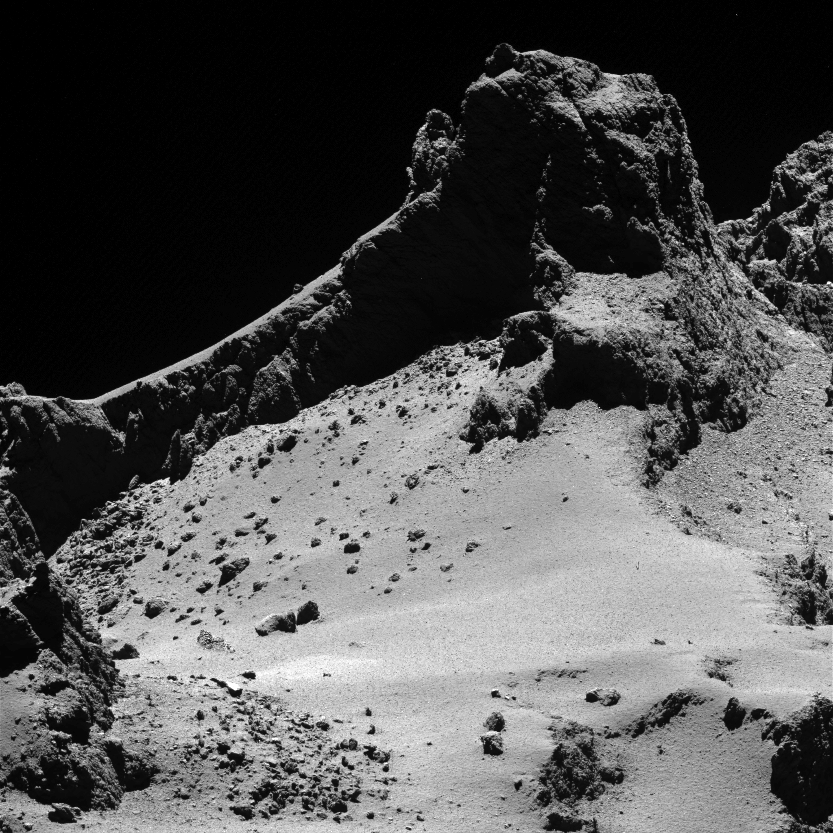
From Rosetta to Comet Interceptor
Rosetta was a huge scientific and engineering success.
First mission to soft-land on a comet & to operate near an active object, for 2.5 years.
Improved our understanding of comets, e.g.:
Cometary geology
A very young research field; received a huge boost from Rosetta.
Numerous morphological features discovered.
Some of the questions raised
How pristine is 67P?
Are the observed pits, terraces, fractures primordial?
How many of the surface features are evolutionary?
ESA/Rosetta/MPS for OSIRIS Team

Slide 4
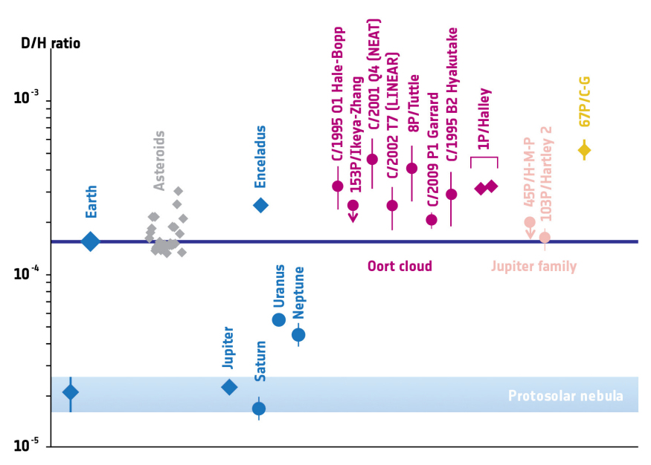
From Rosetta to Comet Interceptor
Cometary Composition
Surprising isotopic ratios observed.
First detection of molecular O₂ at a comet.
Some of the questions raised
Is the current composition evolved or primordial?
Are the differences in composition seen in the coma and solar wind interaction spatial or temporal in origin?
Rosetta hasn’t answered all questions!
Data from Altwegg et al. 2014 and references therein

Slide 5
All previous comet missions have been to objects that have passed the Sun many times
Those comets have changed over time, and are covered in a thick layer of dust
A dynamically-new comet is one that is probably nearing the Sun for the first time
These object are pristine
Comet Interceptor is a mission targeting a long-period comet, preferably dynamically-new, or an interstellar object. Why?

Slide 6
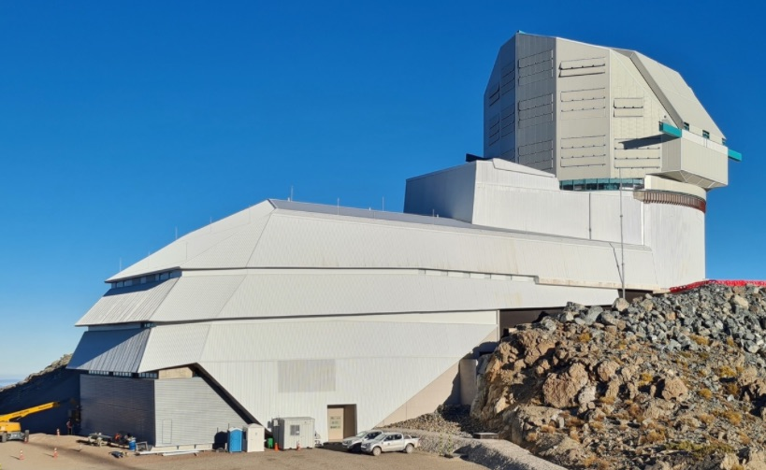
How?
The only way to encounter a long period comet is to find one inbound very early
The upcoming Vera Rubin Observatory – LSST - will increase the distance at which comets are discovered inbound
Even with advance warning, still not enough time to plan and build a spacecraft
Rubin Obs/NSF/AURA

Slide 7
Solution: We Wait, in Space
ESA
We build a spacecraft that can cope with all kinds of comets
We launch it to a stable ‘parking’ location in space
We can respond rapidly to new discoveries - departure from parking location 6-12 months after target discovery

Slide 8
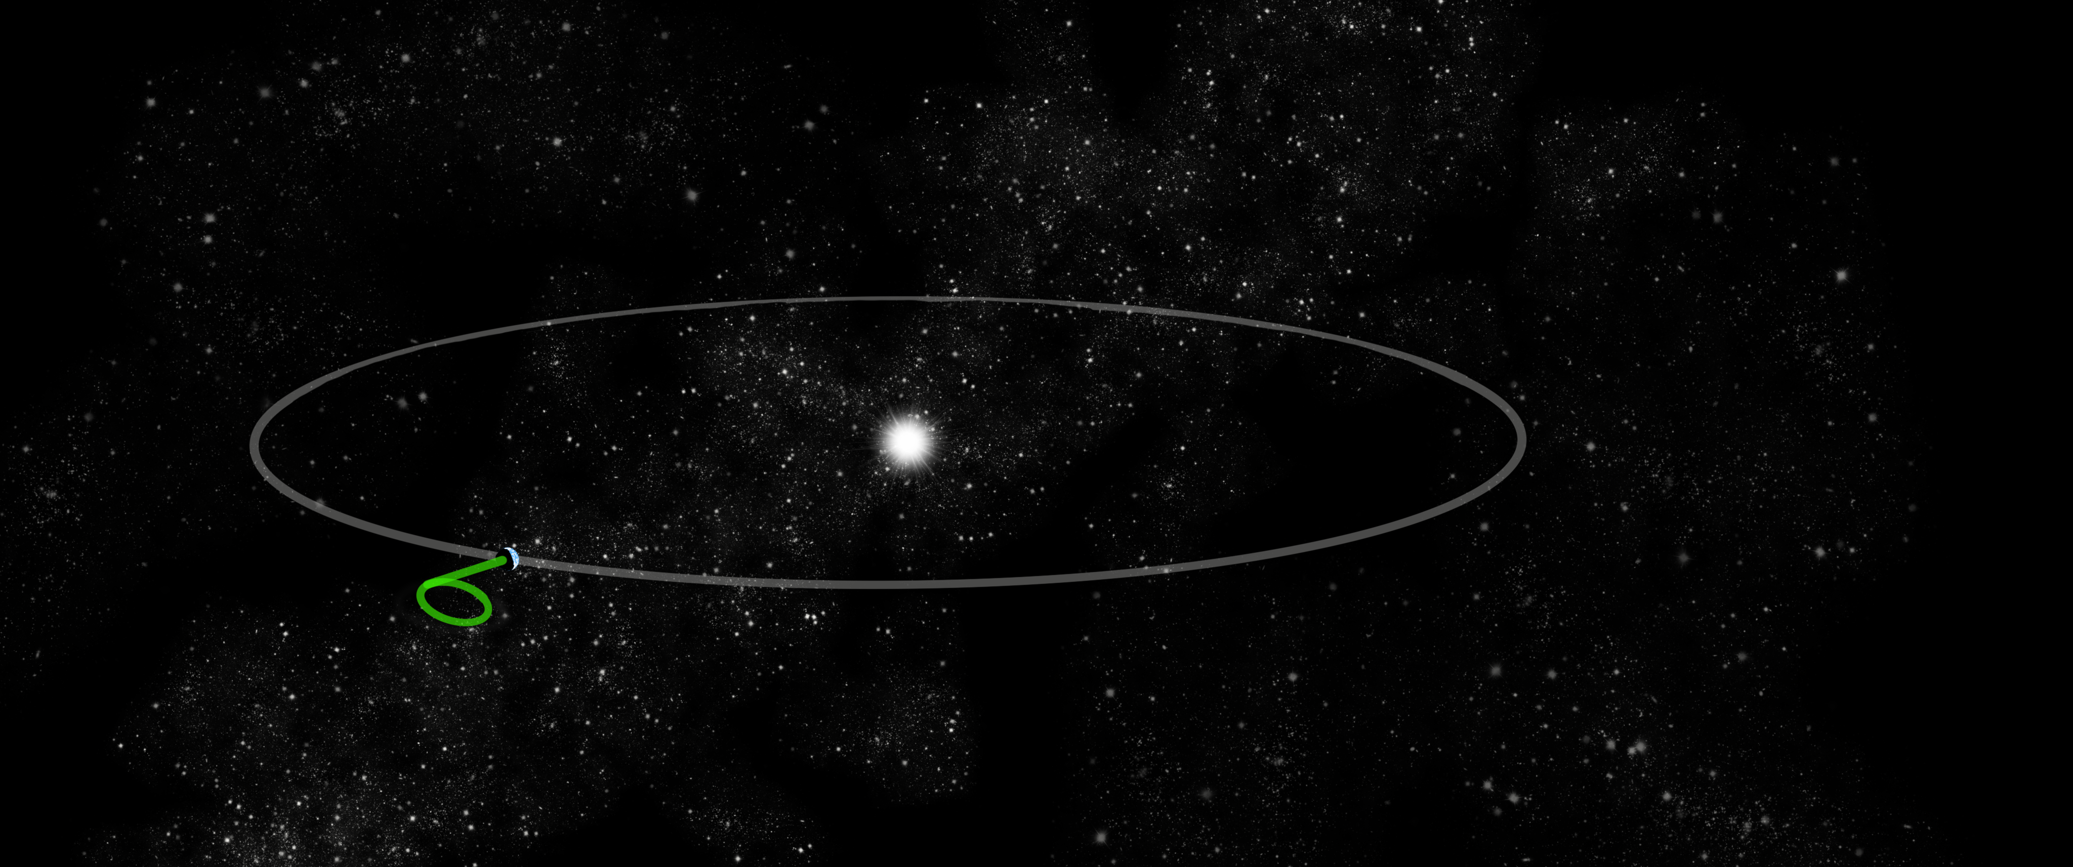
Mission ‘parked’ at stable Lagrange point L2 after launch with Ariel
Waits for up to 3-4 years for new target discovery
Short cruise and fast flyby of target comet near Earth’s distance from the Sun; encounter has to take place close to the ecliptic – the plane of Earth’s orbit

Slide 9
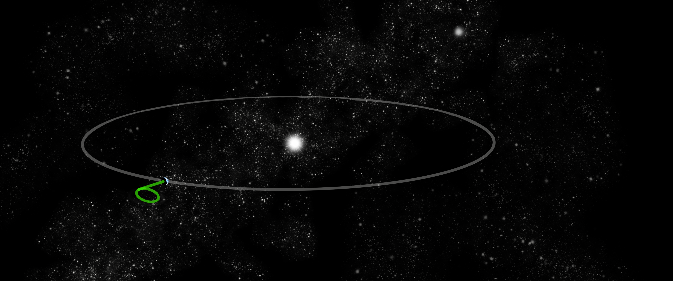
Target discovered by a ground-based observatory

Slide 10
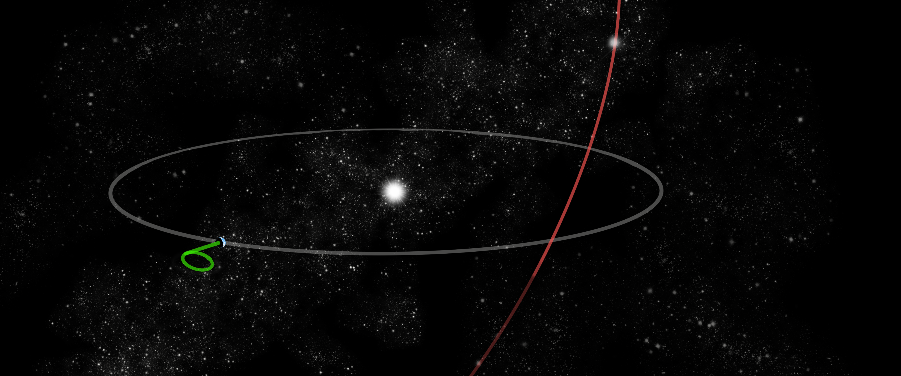
Orbit computed and ecliptic crossing point predicted

Slide 11
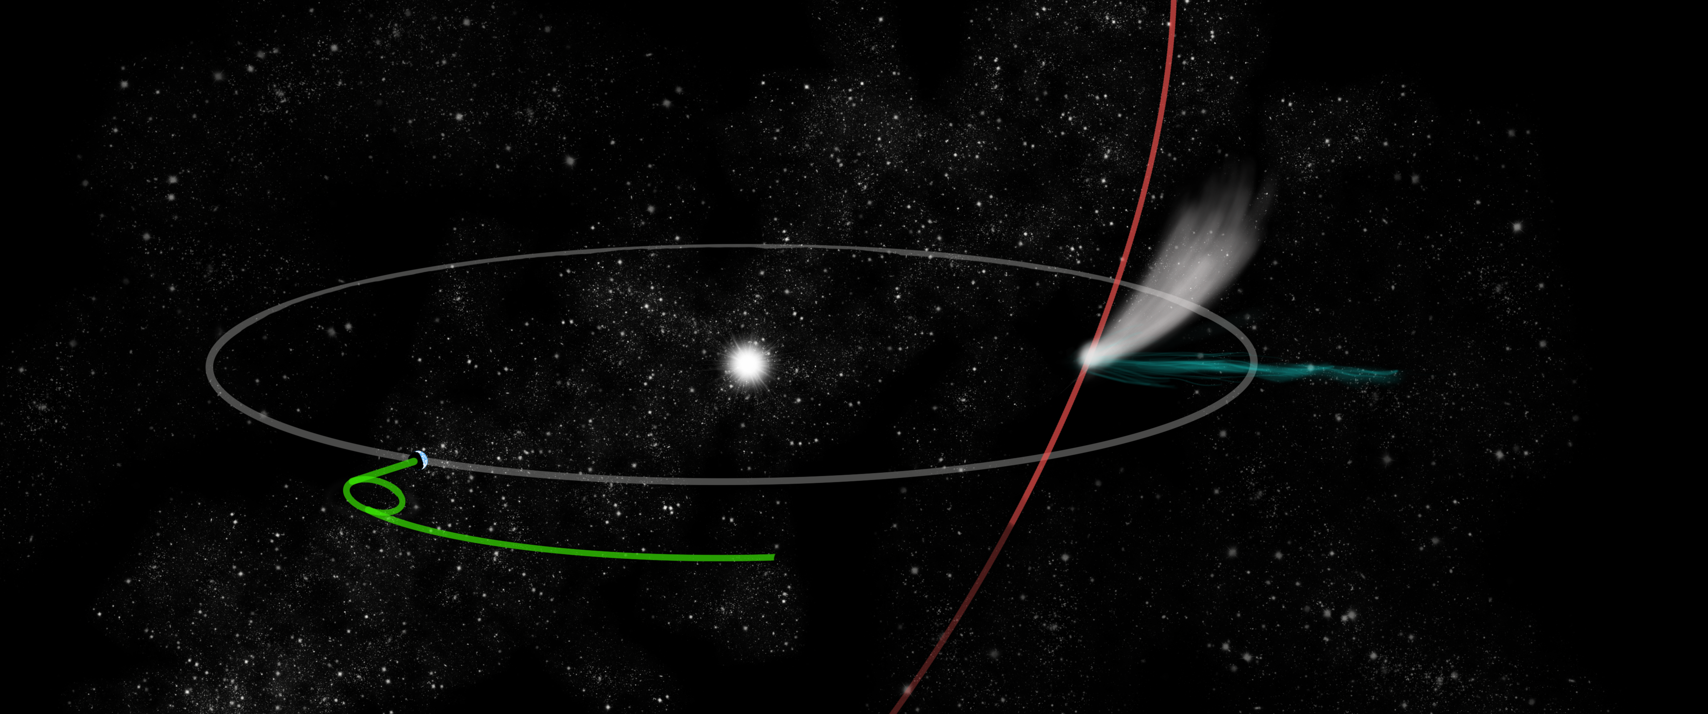
Comet Interceptor leaves L2 to intercept comet’s path

Slide 12
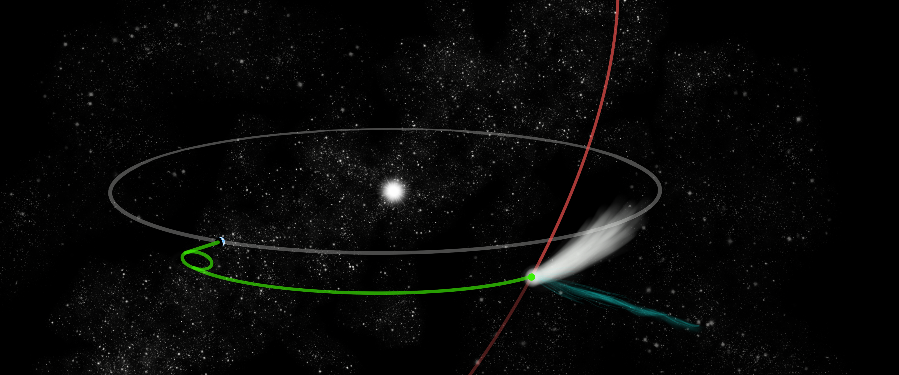
Encounter with comet close to the ecliptic plane
Targets like this are being found, e.g. C/2021 P4 (ATLAS), C/2022 E3 (ZTF) could have been reachable if mission was operating now

Slide 13
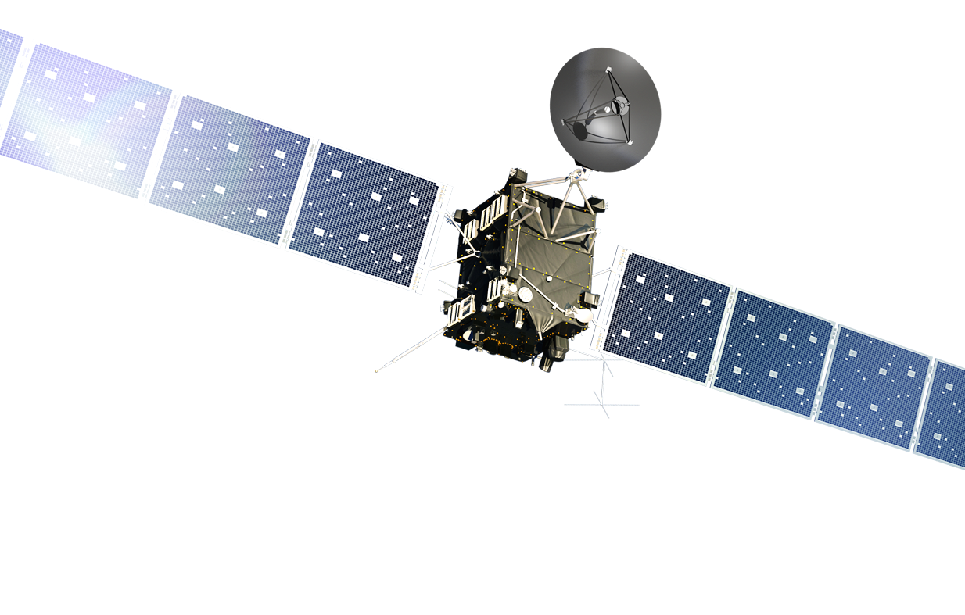
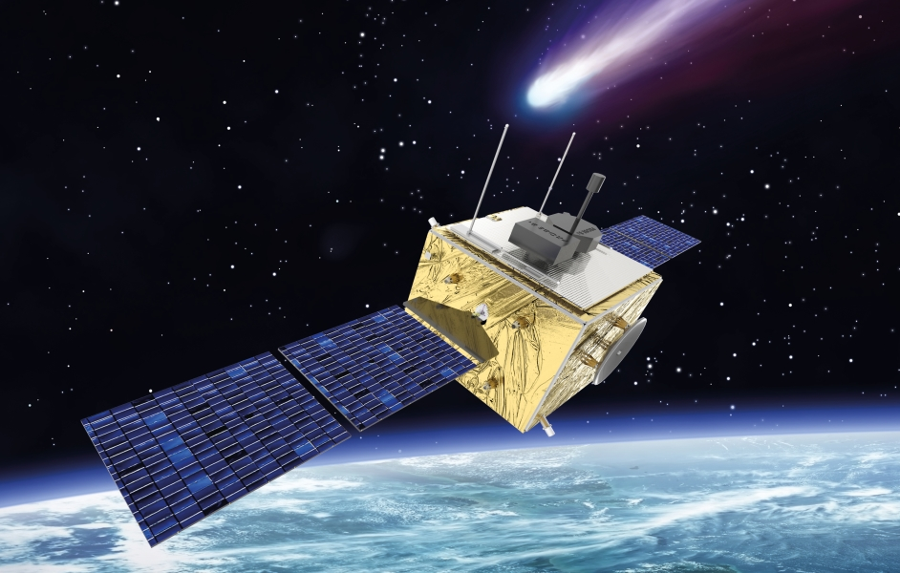
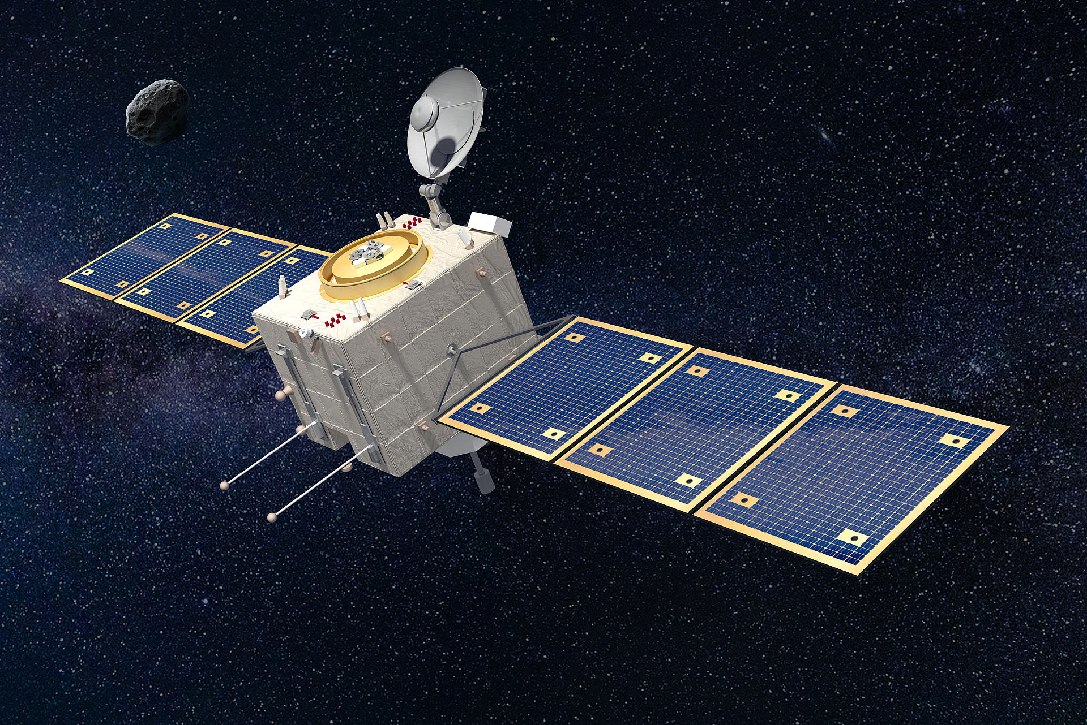
Comet Interceptor: First F class mission
TAS UK
OHB Italia
Rosetta
20 years from proposal to launch
€ 1300M
2900 kg wet mass
2.5 years at the comet
10 years from 2019 selection to 2029 launch
~€150M + shared launch with Ariel at no cost
975 kg wet mass at launch
Fast flyby (~48 hours)

Slide 14
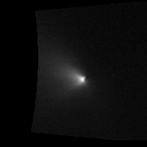
Science objectives (I)
Giotto at Halley: Determined nature of cometary nuclei (confirmed dusty snowball model), localized nature of activity, coma composition.
Rosetta: first detailed “geological” investigation of a comet, monitoring of changes, large particles as driver of activity, detailed molecular and isotopic composition
There are still important open questions:
What properties are primordial, and reflect the process of comet formation, and what are evolutionary features?
How do these properties control cometary activity?
Are the differences in composition seen in the coma and solar wind interaction spatial or temporal in origin?
Comet Interceptor aims to address these by making unique multi-point measurements at a much more pristine type of comet, either Long-Period or Dynamically-New.

Slide 15
Science objectives (II)
The primary goals of Comet Interceptor are:
to provide the first in-situ characterization of a long period comet, which could be dynamically-new or an interstellar object.
to perform the first simultaneous multi-point exploration of a cometary coma & nucleus.
The science of the mission is split between two themes:
1. Comet Nucleus Science
2. Comet Environment Science
NASA
Notes:
Giotto: 1986, Rosetta: 2014 – about 30 years

Slide 16
Science objectives (III)
Comet Nucleus Science - What is the surface composition, shape, morphology, and structure of the target object?
Investigate which features seen on 67P and other short period comets (layered structures, large pits, terraces) are present on an LPC, i.e. primordial
Search for large-scale structures that may represent formation processes
Surface composition: Evidence for e.g. volatile organics that may be absent in more evolved comets?
Presence of surface ice
NASA

Slide 17
Science objectives (III)
Comet Environment Science - What is the composition of the coma, its connection to the nucleus (activity) and the nature of its interaction with the solar wind?
Is the coma composition different from that measured in SPCs (e.g. more super-volatiles)? Is this difference reflected in surface morphology?
characterise the coma dust properties, including for the first time with polarimetry: Are they similar to the 67P dust, claimed by some to be primordial?
Take advantage of multi-point measurements to determine motion and evolution of ion rays & other coma & tail features including dust and gas.
characterise the plasma environment around the target, determining resulting boundaries & assess energy, mass & momentum transfer.

Slide 18
A Multi-Spacecraft Mission
safe / distant measurements
‘safe’ flyby distance
A: main spacecraft
B1: inner coma
B2: nucleus + coma
higher risk / high gain
closer approaches
to nucleus
To separate time and space variation in the coma
To enable simultaneous coma + nucleus + solar wind interaction studies at different distances
To separate safe / distant measurements and high risk / high gain close approaches

Slide 19
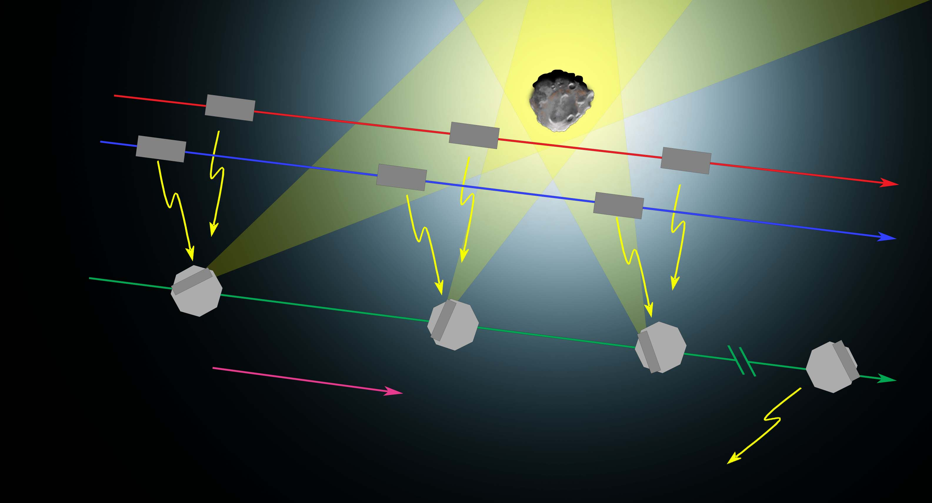
Flyby scenario
Probe B2
Probe B1
Data sent from B1 and B2 to A
Spacecraft A
~10 to ~70 km/s
Data transmission after encounter
Everything – from S/C B1 and B2 release to end of operations – happens within a few days!

Slide 20
Instruments – ESA spacecraft
Spacecraft A
Probe B2
CoCa - Comet Camera Visible-NIR; high resolution views of nucleus PI: Nicolas Thomas, University of Bern, CH
MIRMIS - Multispectral InfraRed Molecular & Ices Sensor First thermal IR mapping spectrometer at a comet PI: Neil Bowles, University of Oxford, UK Co-PI: Antti Näsilä, VTT, FI
MANiaC - Mass Analyzer for Neutrals in a Coma
Mass spectrometer PI: Martin Rubin, University of Bern, CH
DFP - Dust, Fields, and Plasma
Multi-sensor fields & particle suite PI Hanna Rothkaehl, CBK PAN, Warsaw, PL
EnVisS - Entire Visible Sky
All-sky camera for dust polarimetry PI: Vania Da Deppo, CNR-Institute for Photonics & Nanotechnologies, Padova, IT
Co-PI: Luisa M. Lara, IAA, Granada, ES
OPIC - Optical Periscope for Comets
Visible light camera PI: Mihkel Pajusalu, Tartu Observatory, University of Tartu, ET
DFP - Dust, Fields, and Plasma
Multi-sensor fields & particle suite PI Hanna Rothkaehl, CBK PAN, Warsaw, PL

Slide 21
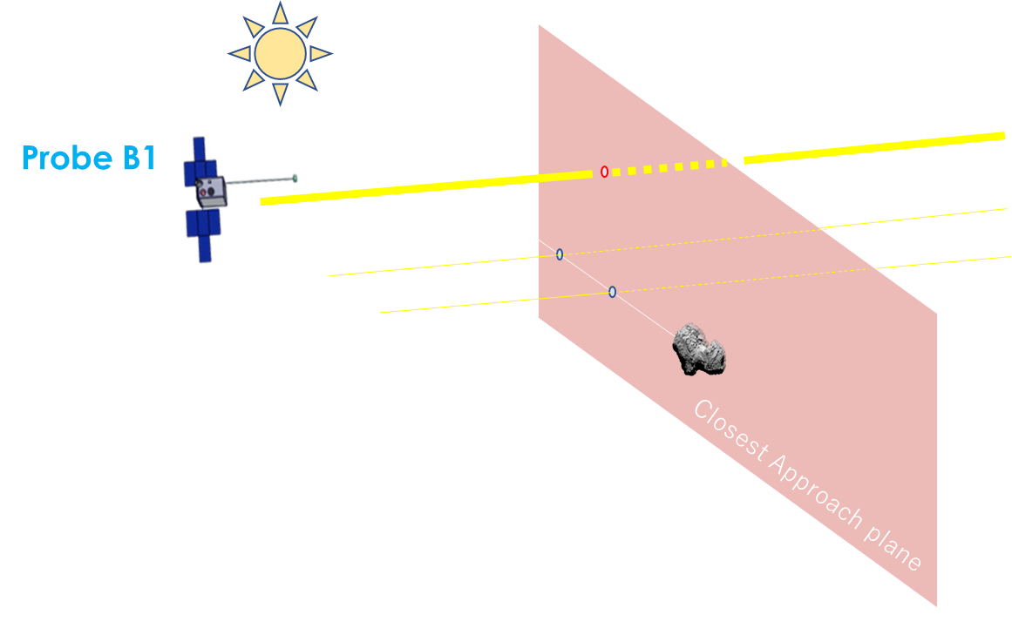
Probe B1: Configuration
JAXA will provide Probe B1
24U CubeSat
Trajectory
S/C A and Probe B2 intercept similar Sun-Target line at closest approach
B1 trajectory will be at a higher inclination
Probe B1 payloads
WAC/ NAC - Wide Angle Camera / Narrow Angle Camera
Visible light --> multi-angle imaging in coordination with CoCa and OPIC
PI: Naoya Sakatani, ISAS/JAXA, JP, Deputy-PI: Shingo Kameda, Rikkyo University, JP
PS - Plasma Suite
Ion and magnetic field --> multi-point plasma measurements in concert with DFP
PI: Satoshi Kasahara, The University of Tokyo, JP, Deputy-PI: Ayako Matsuoka, Kyoto University, JP
HI - Hydrogen Imager
Ultraviolet light --> multi-wavelength imaging of the gas coma, with CoCa and MIRMIS
PI: Kazuo Yoshioka, The University of Tokyo, JP

Slide 22
Probe B1: Science and programmatic view
B1 instruments are connected to most of the science questions
B1 is fundamental to ensure the multi-point capability of the mission
Participation will boost JAXA's strategy for small body exploration and international science coordination between ESA and JAXA, following successes at Halley with Suisei, Sakigake
JAXA's missions and participations for small bodies
Hayabusa2 (asteroids)
Hera (asteroids, led by ESA)
Destiny+ (active asteroid)
MMX (Martian moons)
JUICE (icy moons, led by ESA)
Comet Interceptor (long period comet, led by ESA)

Slide 23
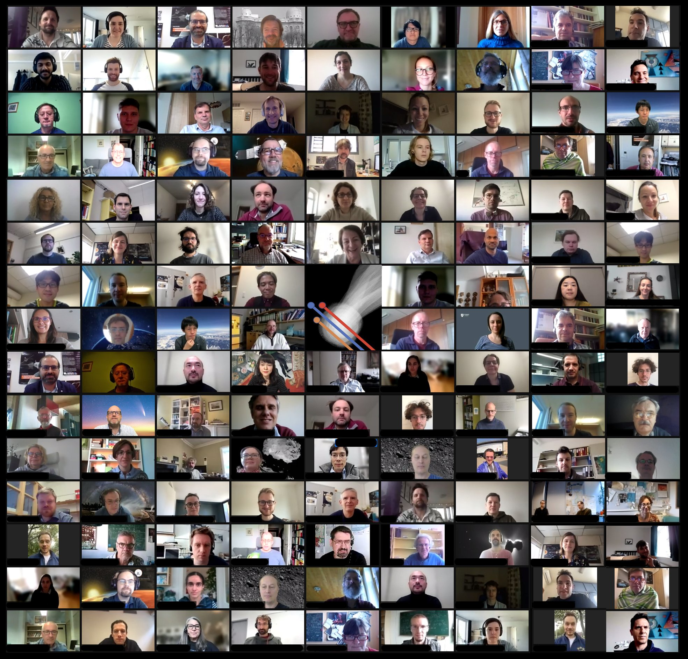
Summary
Unique, first multi-point measurement of a comet and its environment.
The mission will visit the most pristine object to be encountered so far.
Will build on the legacy of international collaboration in cometary science.
First dedicated comet mission launch by any agency for >25 years!
In parallel to ESA activities, very active science consortium of >350 scientists & engineers.
Consortium comprises all instrument teams plus other scientists.
http://www.cometinterceptor.space/
@cometintercept
Notes:
Activities include dust environment modelling; target search; preparatory science discussions with regular meetings; meetings of instrument and science leads every 2 weeks; outreach; full science consortium meetings every ~6 months.

