Slide 1
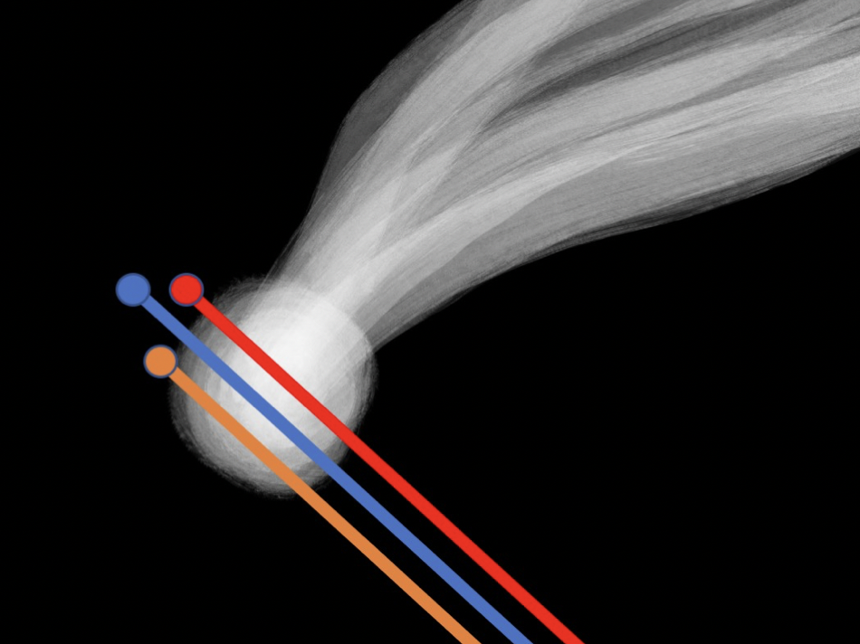
The Comet Interceptor Mission
Geraint Jones
UCL Mullard Space Science Laboratory, UK
Centre for Planetary Science at UCL/Birkbeck, UK
Colin Snodgrass
University of Edinburgh, UK
Cecilia Tubiana
INAF-IAPS, Rome, Italy
and the Comet Interceptor Team
@cometintercept

Slide 2
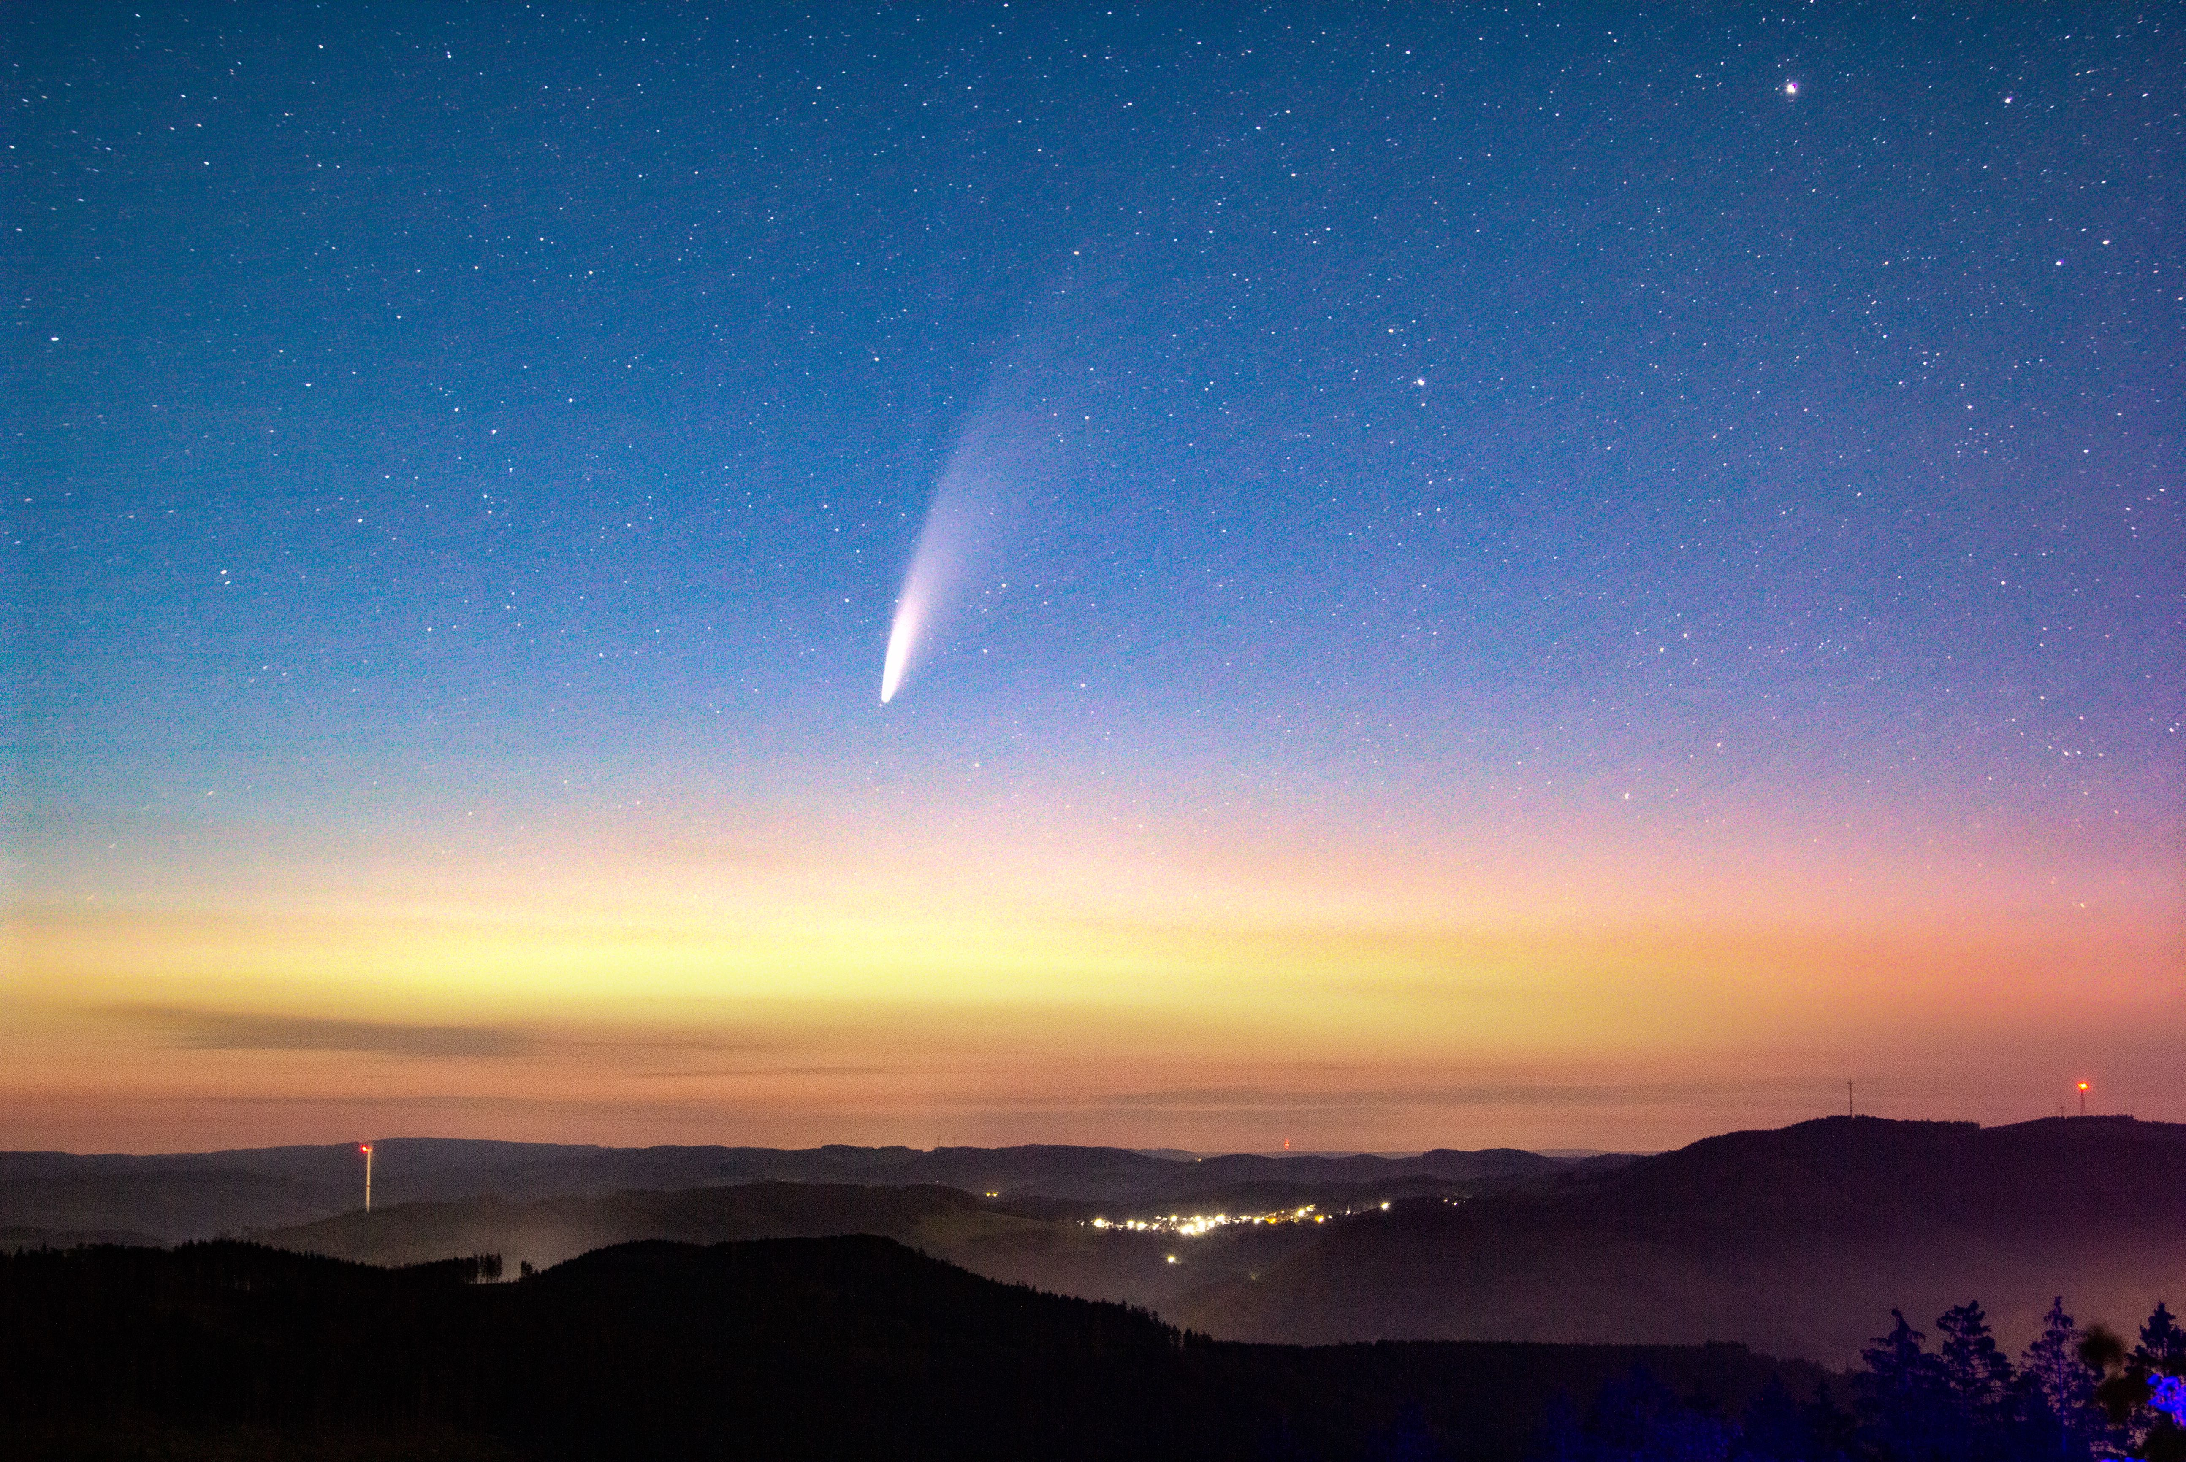

Slide 3
Comet Interceptor is a mission targeting a long-period comet, preferably dynamically-new, or an interstellar object. Why?
All previous comet missions have been to objects that have passed the Sun many times
Those comets have changed over time, and are covered in a thick layer of dust
A dynamically-new comet is one that is probably nearing the Sun for the first time
These are pristine

Slide 4
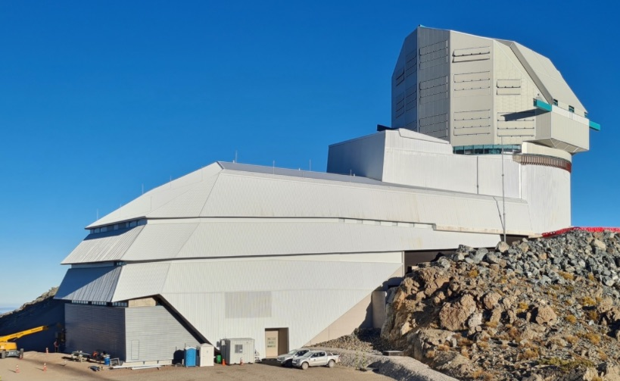
How?
The only way to encounter a long period comet is to find one inbound very early
The upcoming Vera Rubin Observatory (formerly LSST) will increase the distance at which comets are discovered inbound
Even with advance warning, still not enough time to plan and build a spacecraft
Rubin Obs/NSF/AURA

Slide 5
Solution: We Wait, in Space
ESA
We build a spacecraft that can cope with all kinds of comets
We launch it to a stable ‘parking’ location in space
We can respond rapidly to new discoveries - departure from parking location 6-12 months after target discovery

Slide 6
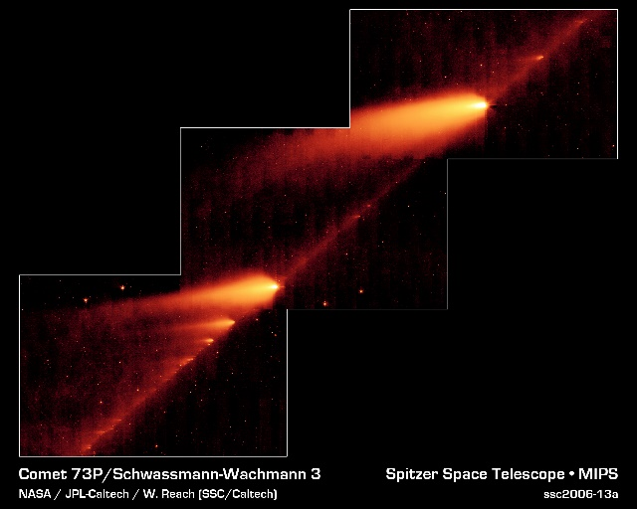
Challenges
We may encounter comets at > 70 km/s
We can’t predict our path through the comet
Cost limit means that entire mission should be < 5 years in duration
Solutions
Limited radio link to Earth at encounter
Dust shielding equivalent to that on Giotto
Wait at L2 limited to ~3 years
Backup short period comet targets
A mission to short period comet will carry out new science: not repeat of previous missions.

Slide 7
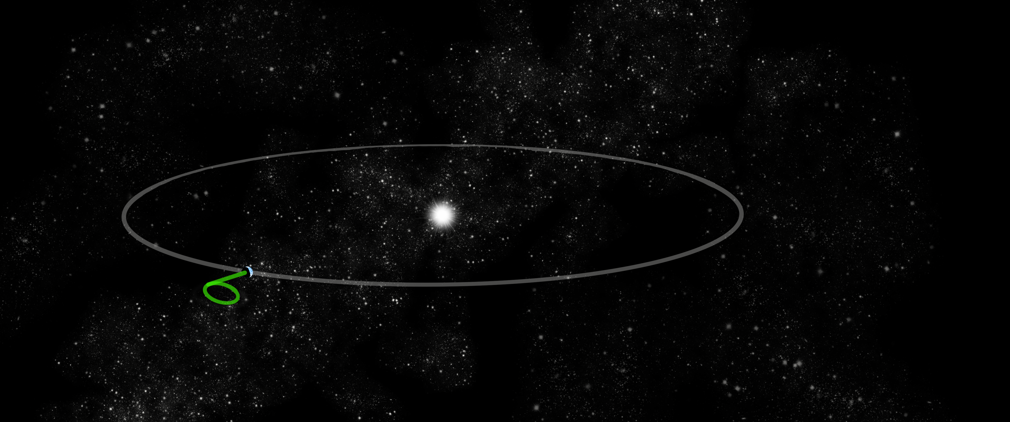
Mission ‘parked’ at stable Lagrange point L2 after launch with Ariel
Waits for up to 2-3 years for new target discovery
Short cruise and fast flyby of target comet near Earth’s distance from the Sun; encounter has to take place close to the ecliptic – the plane of Earth’s orbit

Slide 8
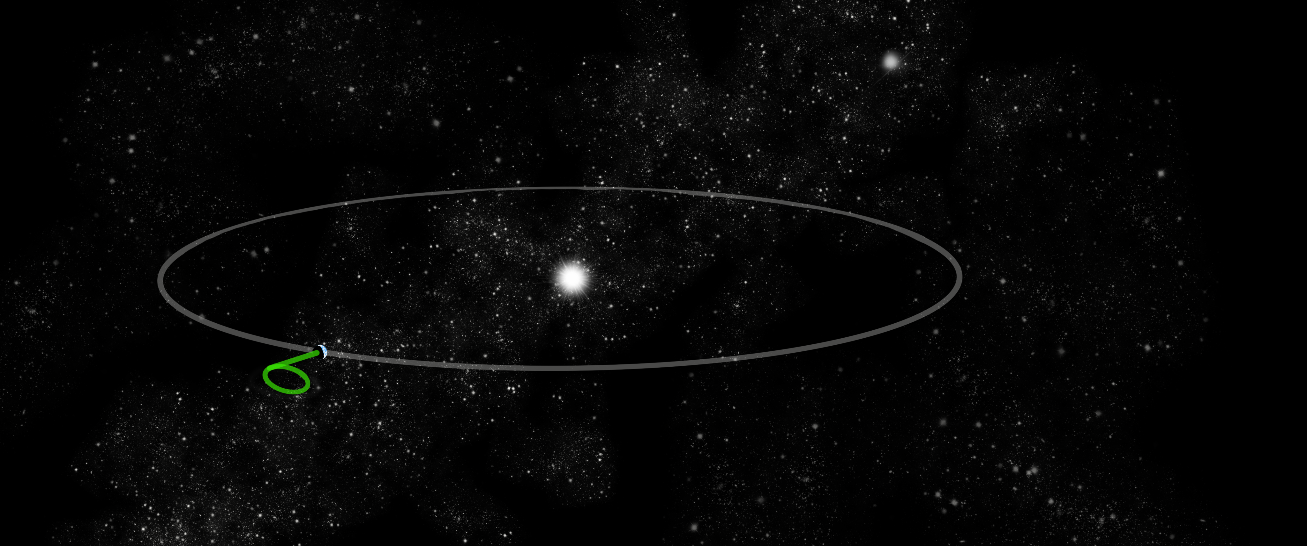
Target discovered by a ground-based observatory

Slide 9
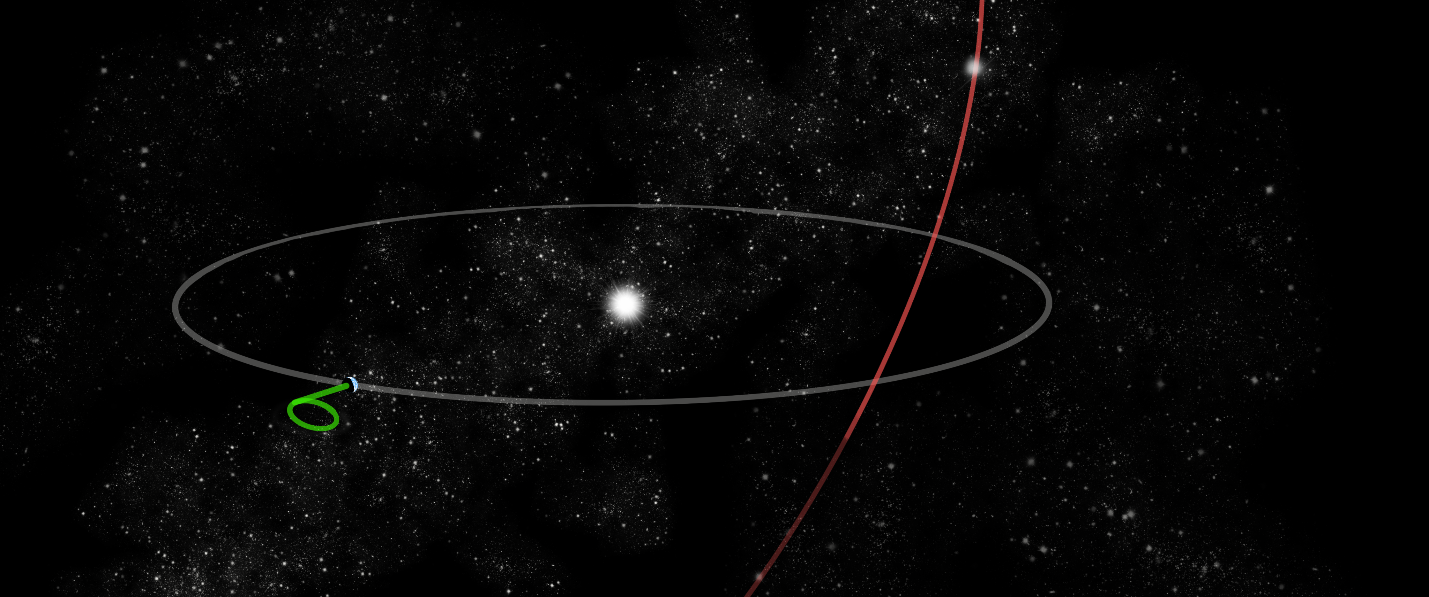
Orbit computed and ecliptic crossing point predicted

Slide 10
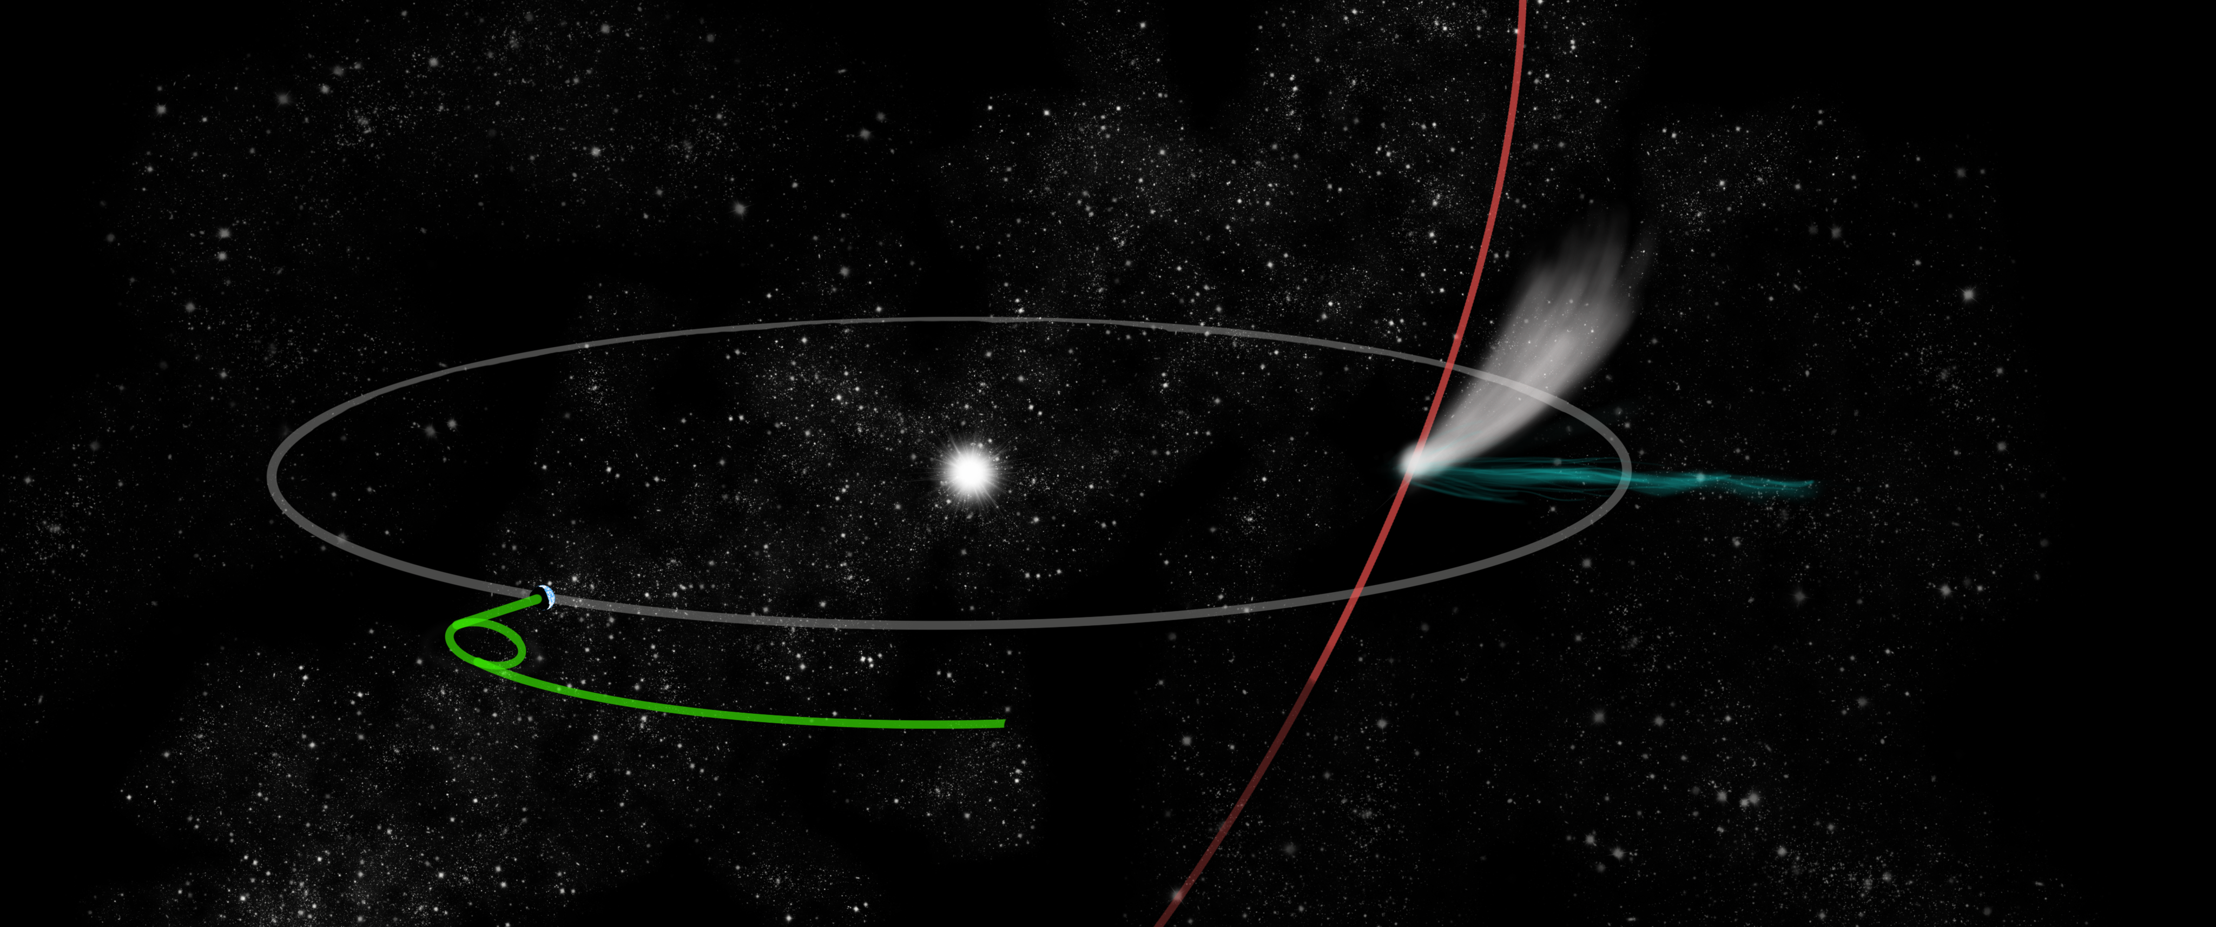
Comet Interceptor leaves L2 to intercept comet’s path

Slide 11
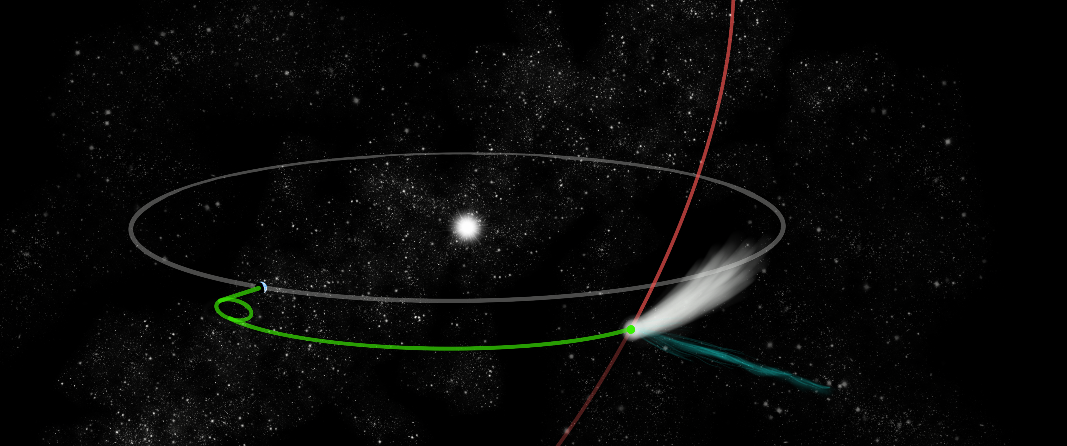
Encounter with comet close to the ecliptic plane
Targets like this are being found, e.g. C/2021 O3 (Pan-STARRS) and C/2021 P4 (ATLAS), found in July-August 2021, could have been reachable if mission was operating now

Slide 12
A Multi-Spacecraft Mission
A: main spacecraft
B1: inner coma
B2: nucleus + coma
safe / distant measurements
higher risk / high gain
closer approaches
to nucleus

Slide 13
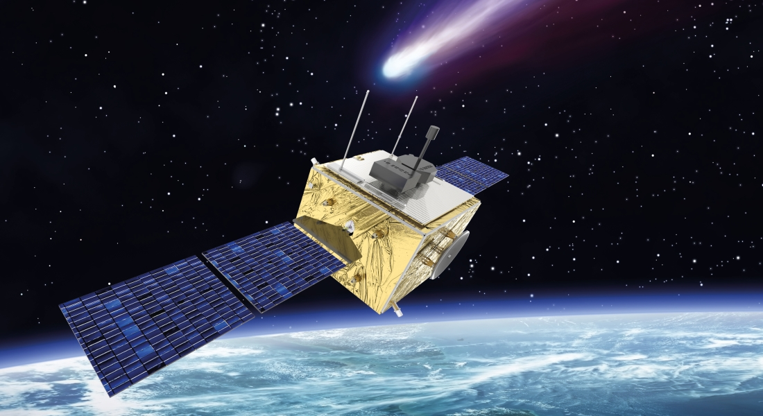
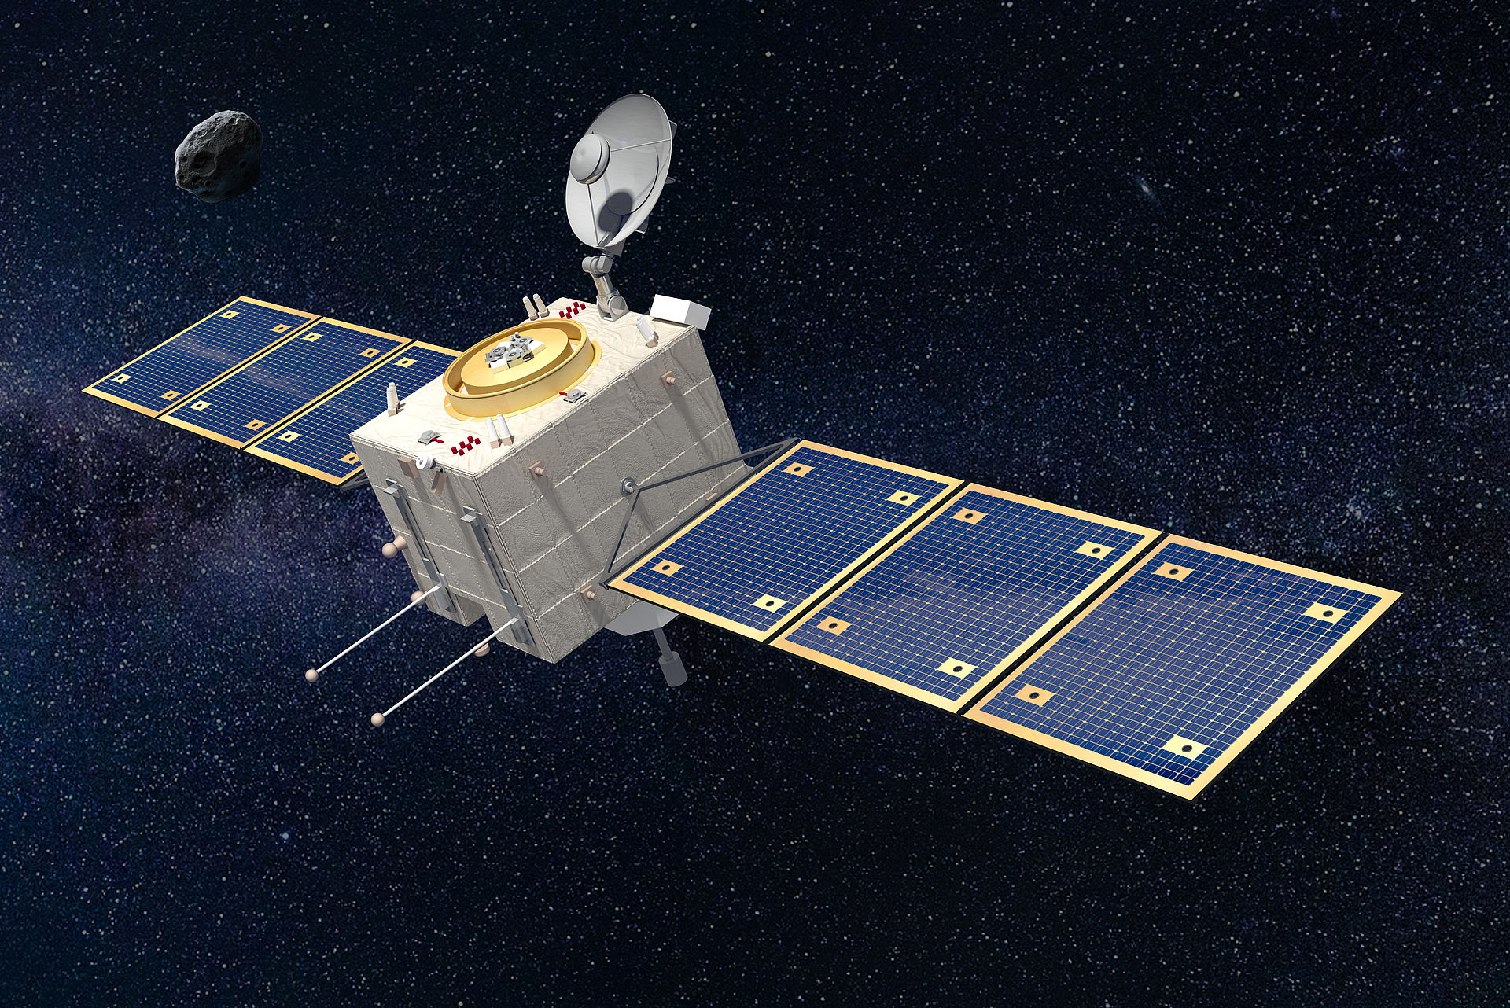
Spacecraft Design
Two industrial consortia contracted by ESA to design Spacecraft A and B2 (B1 provided by Japan).
One of those two teams will be selected next year to be the prime contractor.
Thales Alenia Space UK
OHB Italia

Slide 14
Probe B1
PS - Plasma Suite PI: Satoshi Kasahara, The University of Tokyo, JP Deputy-PI: Ayako Matsuoka, Kyoto University, JP WAC/ NAC - Wide Angle Camera / Narrow Angle Camera PI: Naoya Sakatani, Rikkyo University, JP Deputy-PI: Shingo Kameda, Rikkyo University, JP
HI - Hydrogen Imager PI: Kazuo Yoshioka, The University of Tokyo, JP
Instruments
Spacecraft A
CoCa - Comet Camera PI: Nicolas Thomas, University of Bern, CH Deputy PI: Antoine Pommerol, University of Bern, CH
MIRMIS - Multispectral InfraRed Molecular & Ices Sensor PI: Neil Bowles, University of Oxford, UK Co-PI: Antti Näsilä, VTT, FI
MANIAC - Mass Analyzer for Neutrals and Ions at Comets PI: Martin Rubin, University of Bern, CH Deputy PI: Peter Wurz, University of Bern, CH
Probe B2
EnVIsS - Entire Visible Sky PI: Vania Da Deppo, CNR-Institute for Photonics & Nanotechnologies, Padova, IT
Co-PI: Luisa Lara, IAA, Granada, ES
OPIC - Optical Imager for Comets PI: Mihkel Pajusalu, Tartu Observatory, University of Tartu, ET Co-PI: Andris Slavinskis, Aalto University, FI & University of Tartu, ET

Slide 15
Instruments
DAPU Unit Co-PI: Ivana Kolmasova, IAP, Praque, CZ PSU Unit Co-PI: Marek Morawski, CBK PAN, Warsaw, PL
DISC (sensors on A and B2) Unit Co-PI Vincenzo Della Corte, INAF-IAPS, Rome, IT Deputy Unit Co-PI Alessandra Rotundi, University "Parthenope", Naples, IT
Probe B2
FGM (B2) Unit Co-PI: Marina Galand, Imperial College London, UK Deputy Unit Co-PI: Martin Volwerk, Space Research Institute, Austrian Academy of Sciences, Graz, AT
DFP - Dust, Fields, and Plasma PI Hanna Rothkaehl, CBK PAN, Warsaw, PL
Spacecraft A
FGM (A) Unit Co-PI Uli Auster, TU Braunschweig, DE LEES Unit Co-PI: Nicolas Andre, IRAP, FR Deputy Unit Co-PI: Lubomir Prech, Charles University, CZ
COMPLIMENT Unit Co-PI: Pierre Henri, CNRS (LPC2E, Orléans & Lagrange, Nice), FR Deputy Unit Co-PI: Niklas Edberg, IRF-Uppsala, SE Deputy Unit Co-PI: Johan De Keyser, BIRA, BE SCIENA Unit Co-PI: Hans Nilsson, IRF-Kiruna, SE

Slide 16
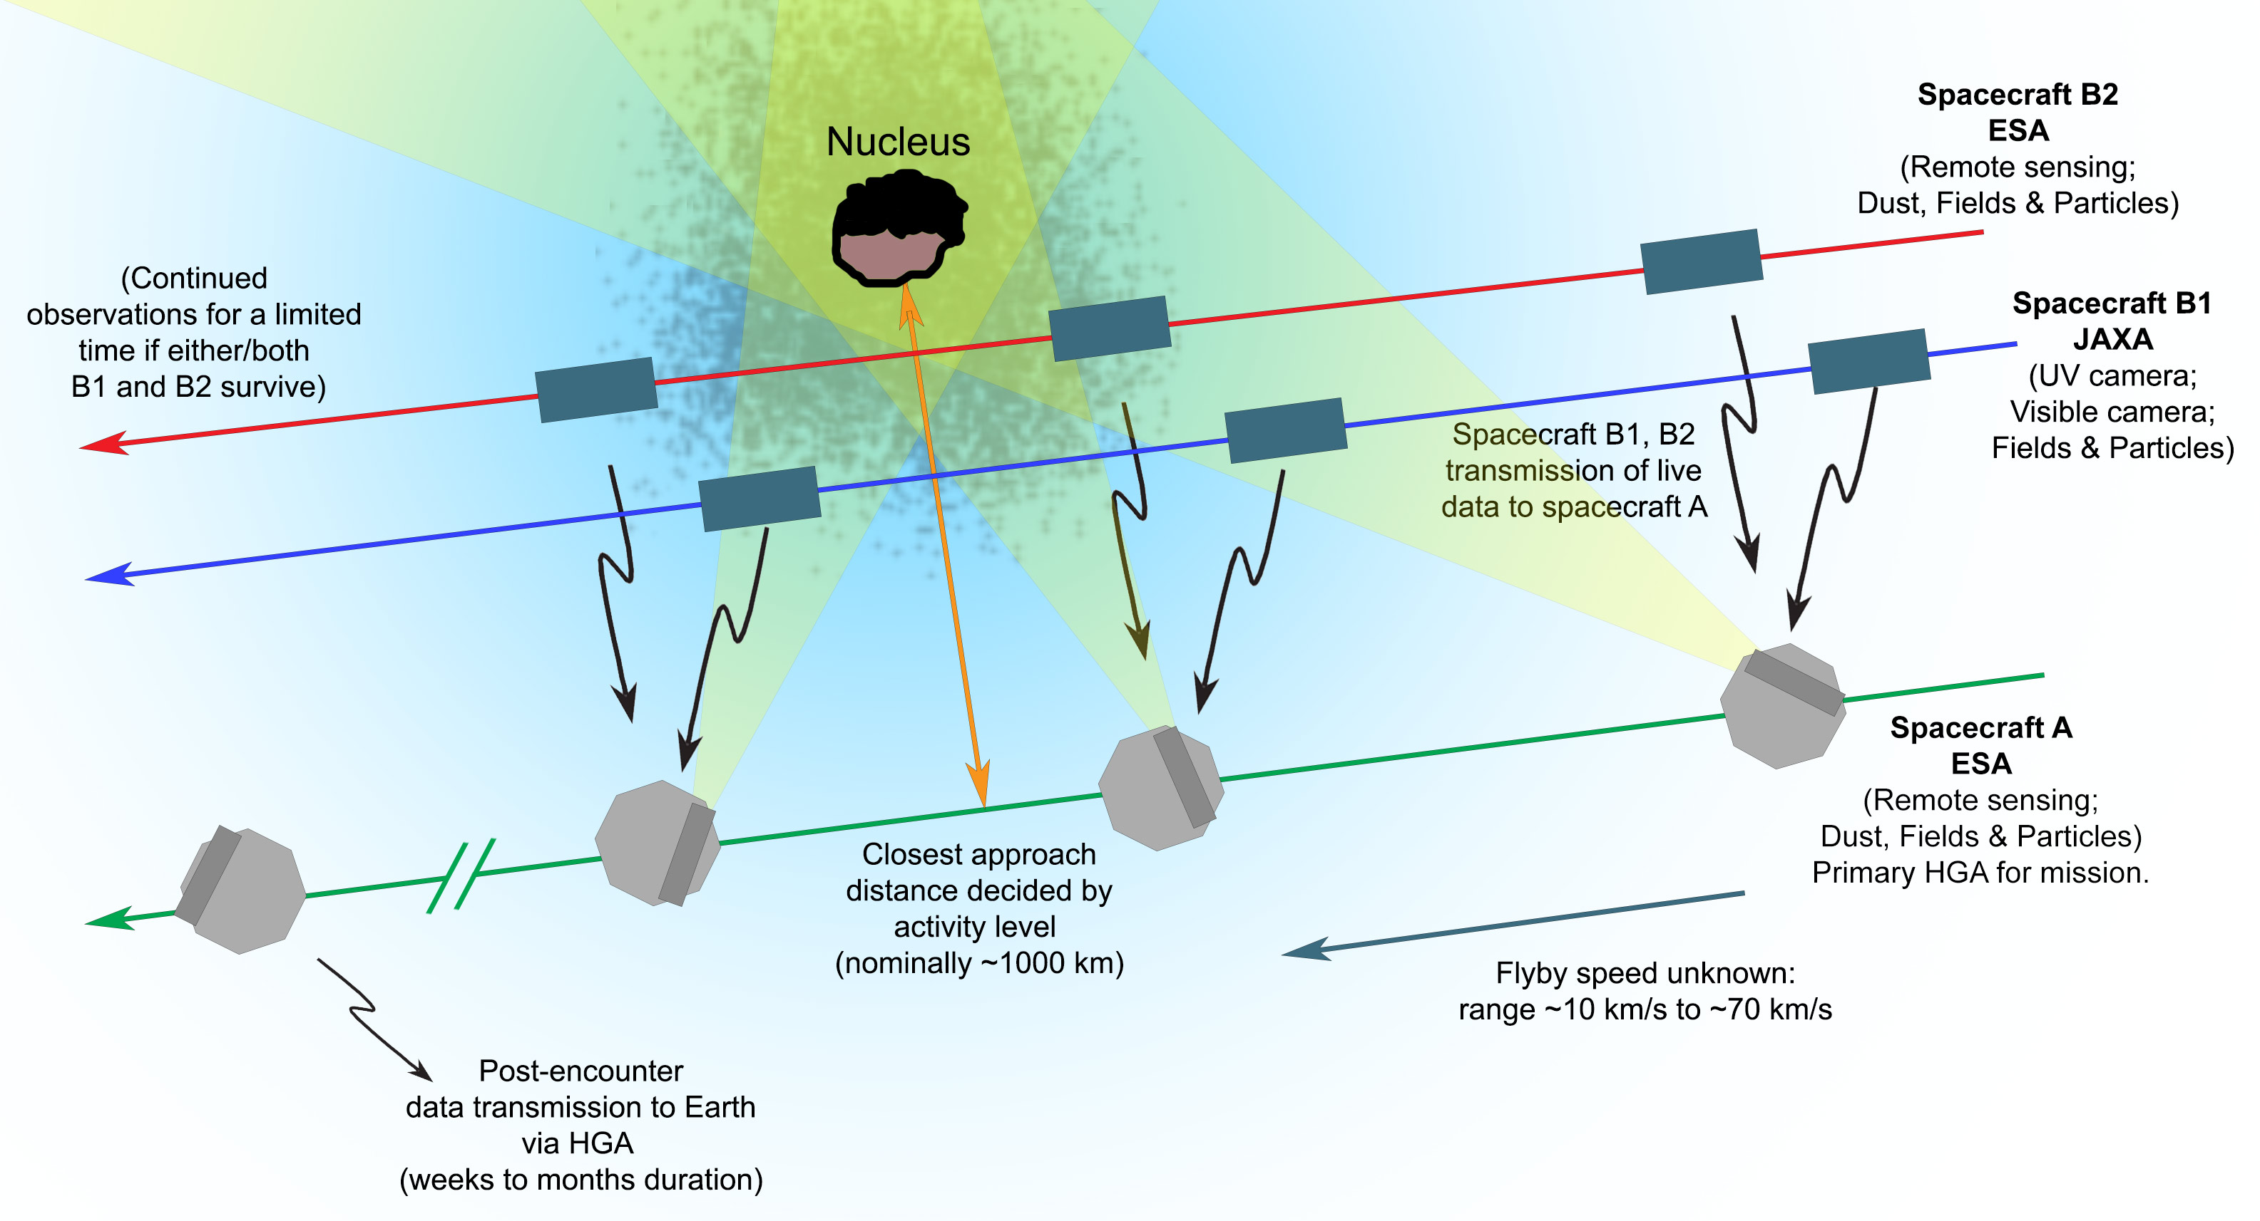

Slide 17
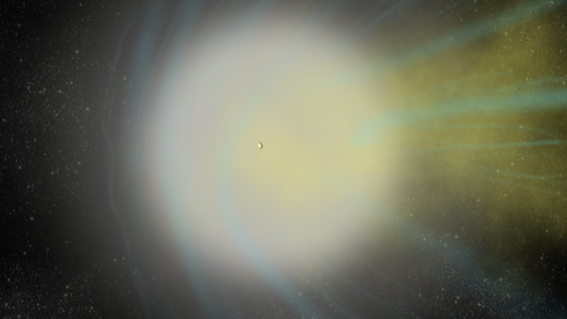

Slide 18
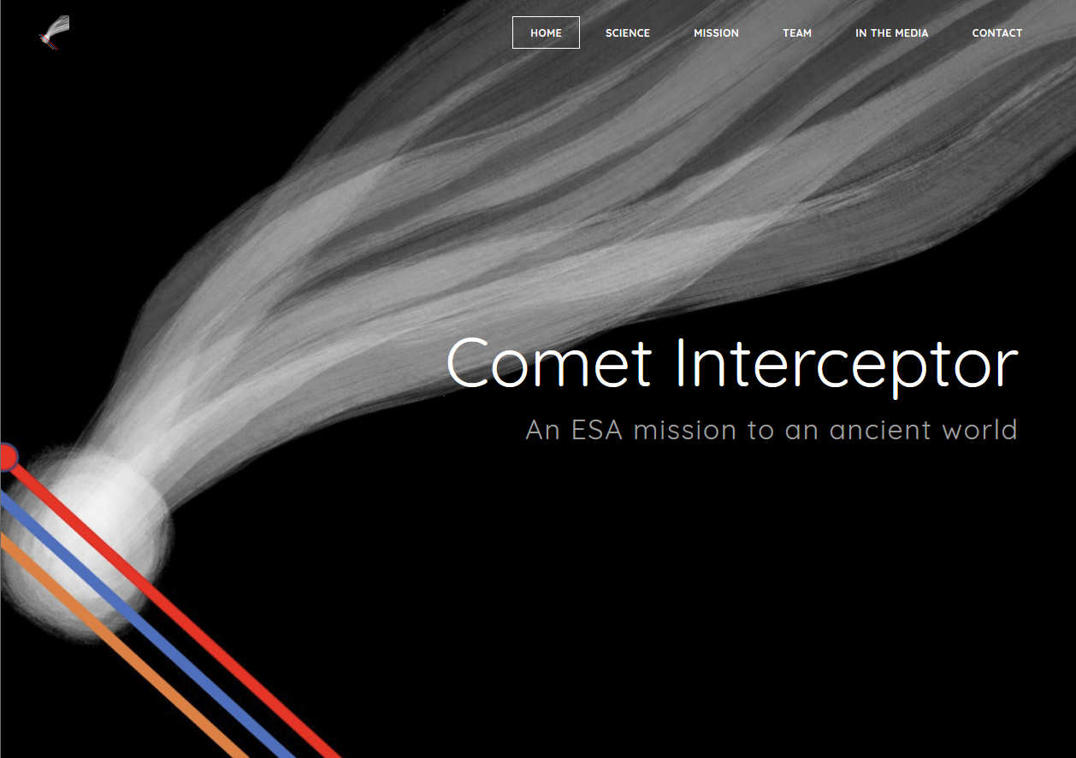
http://www.cometinterceptor.space/
@cometintercept

